Slide 1
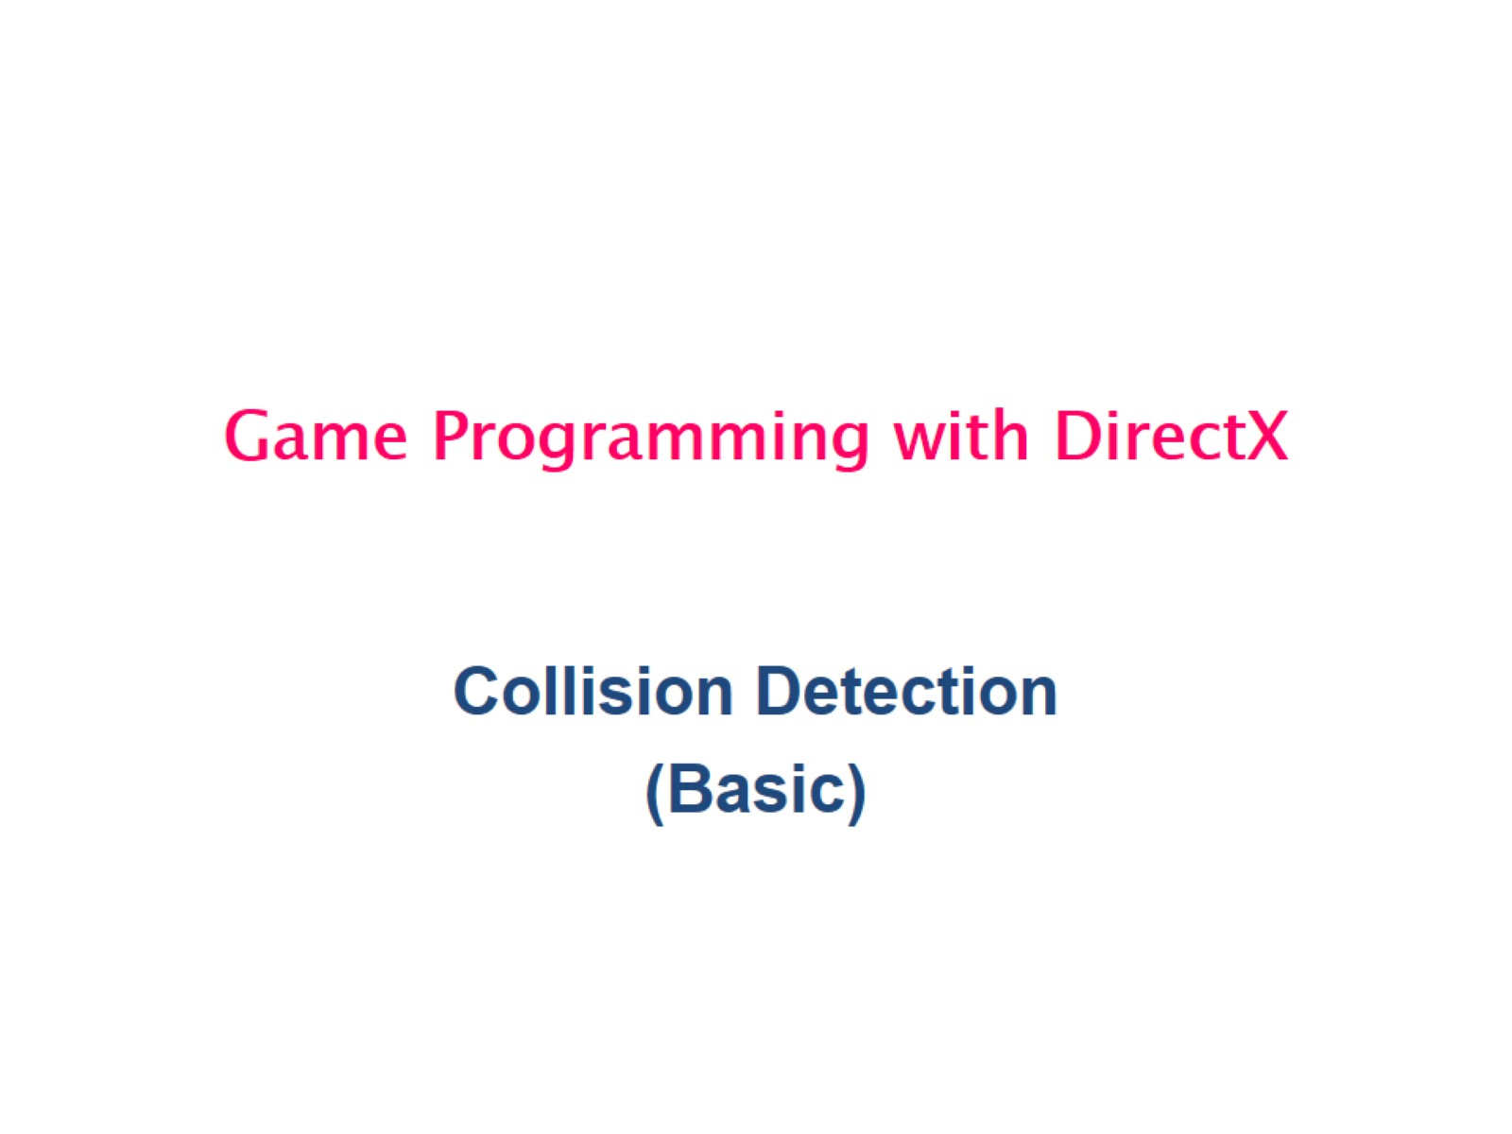
Game Programming with DirectX

Slide 2
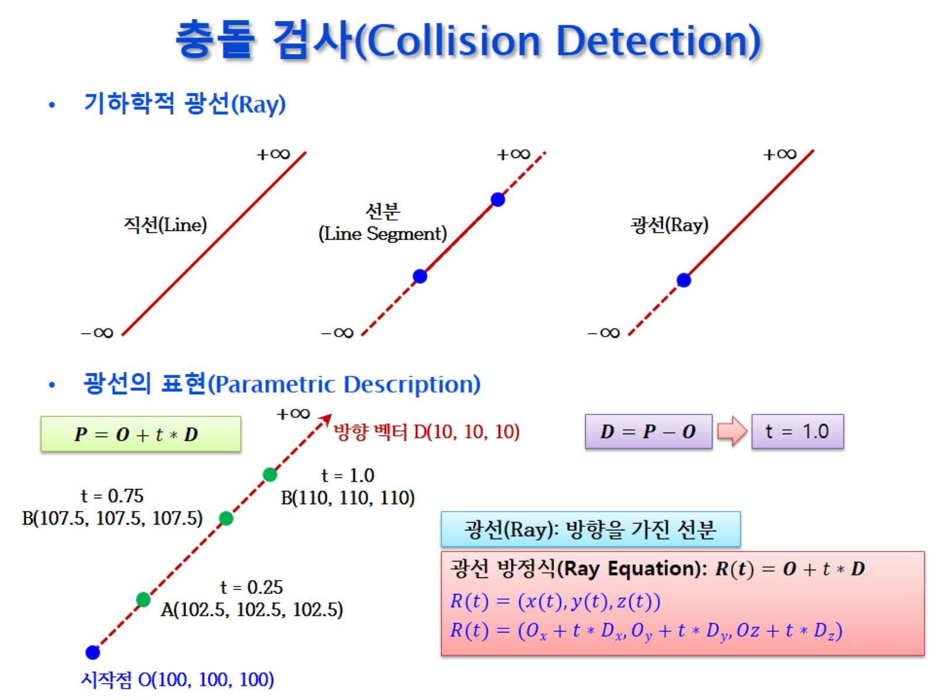
충돌 검사(Collision Detection)

Slide 3
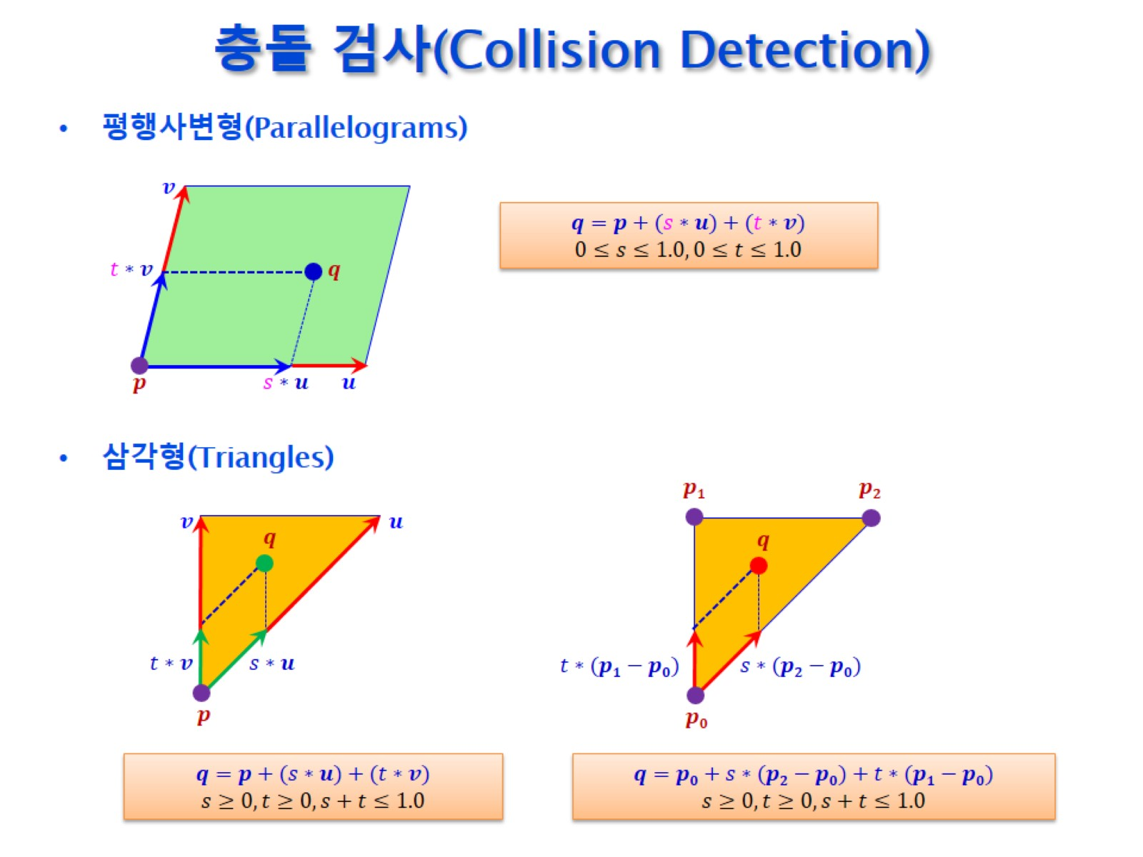
충돌 검사(Collision Detection)

Slide 4
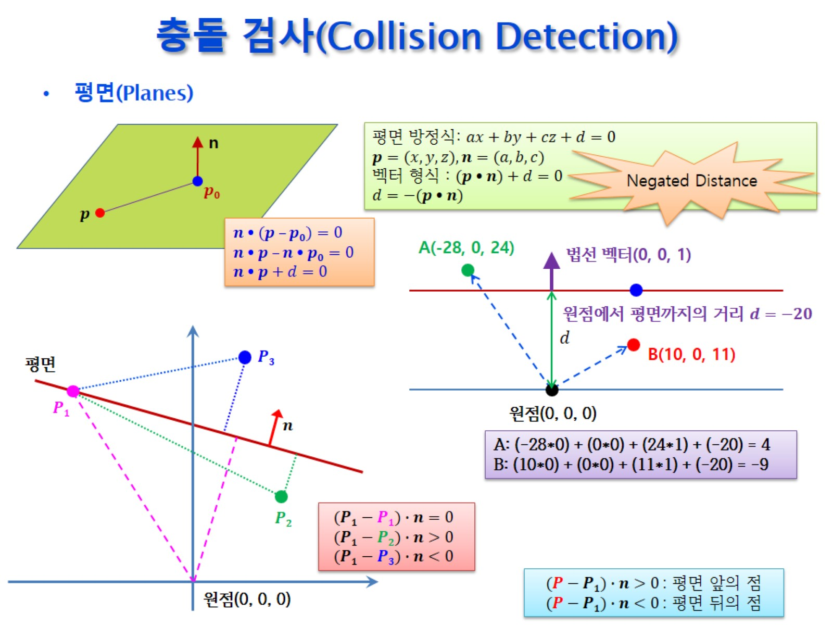
충돌 검사(Collision Detection)

Slide 5
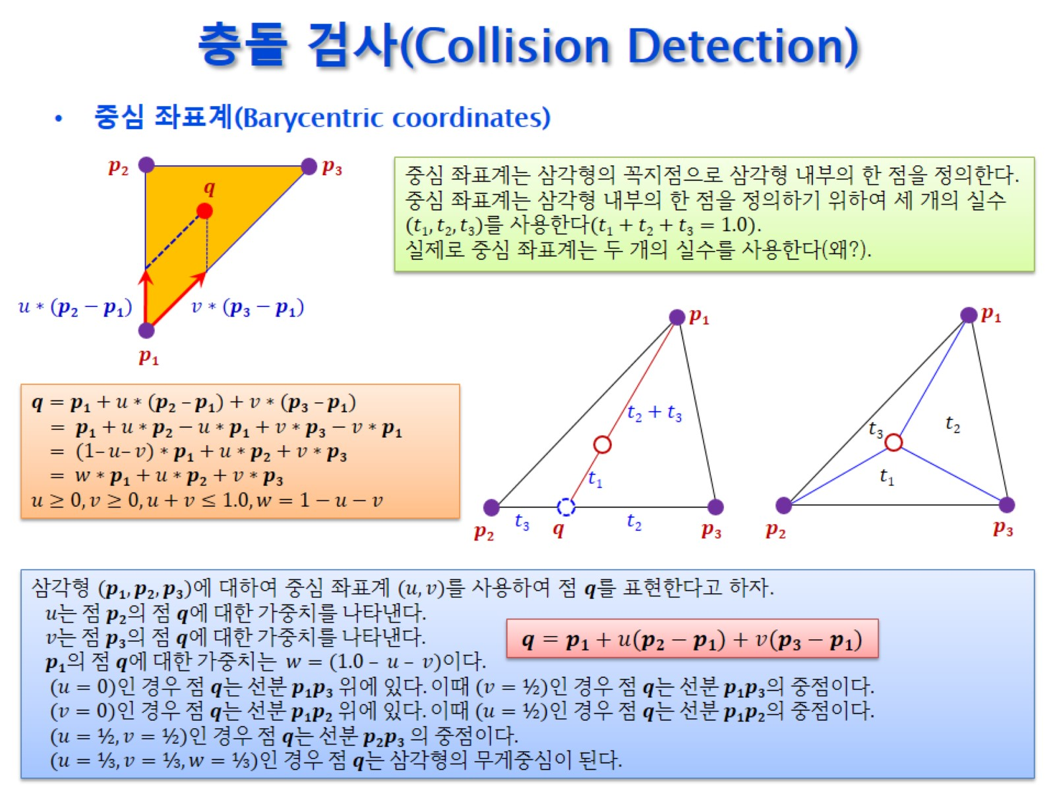
충돌 검사(Collision Detection)

Slide 6
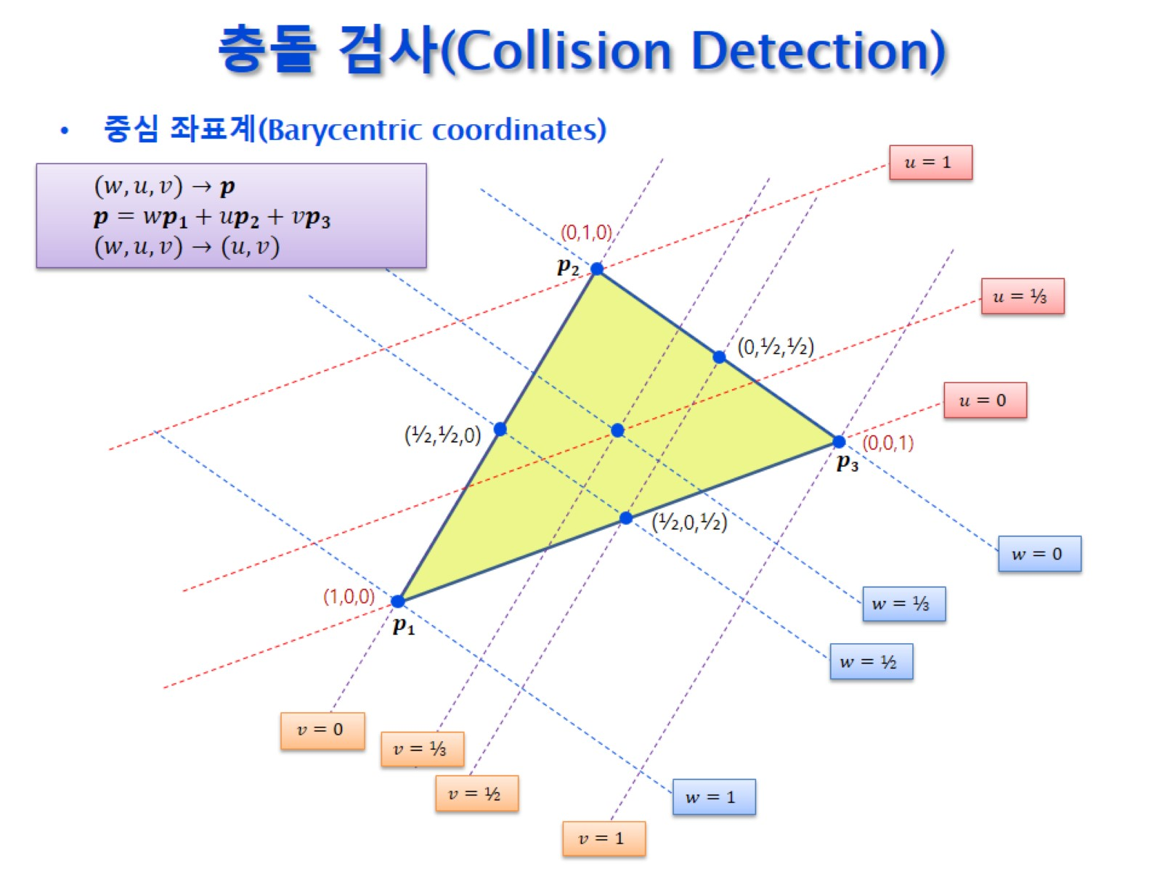
충돌 검사(Collision Detection)

Slide 7
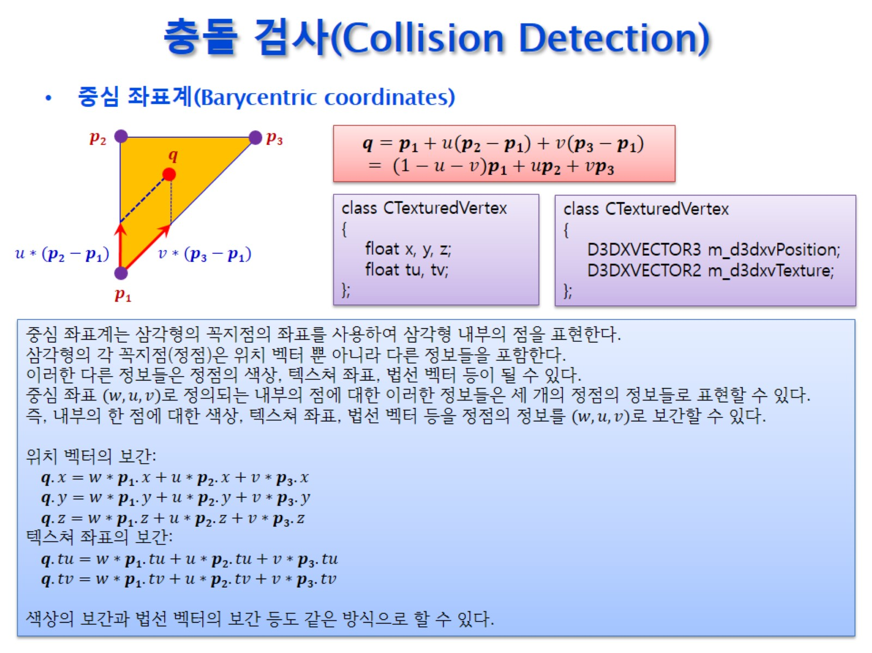
충돌 검사(Collision Detection)

Slide 8
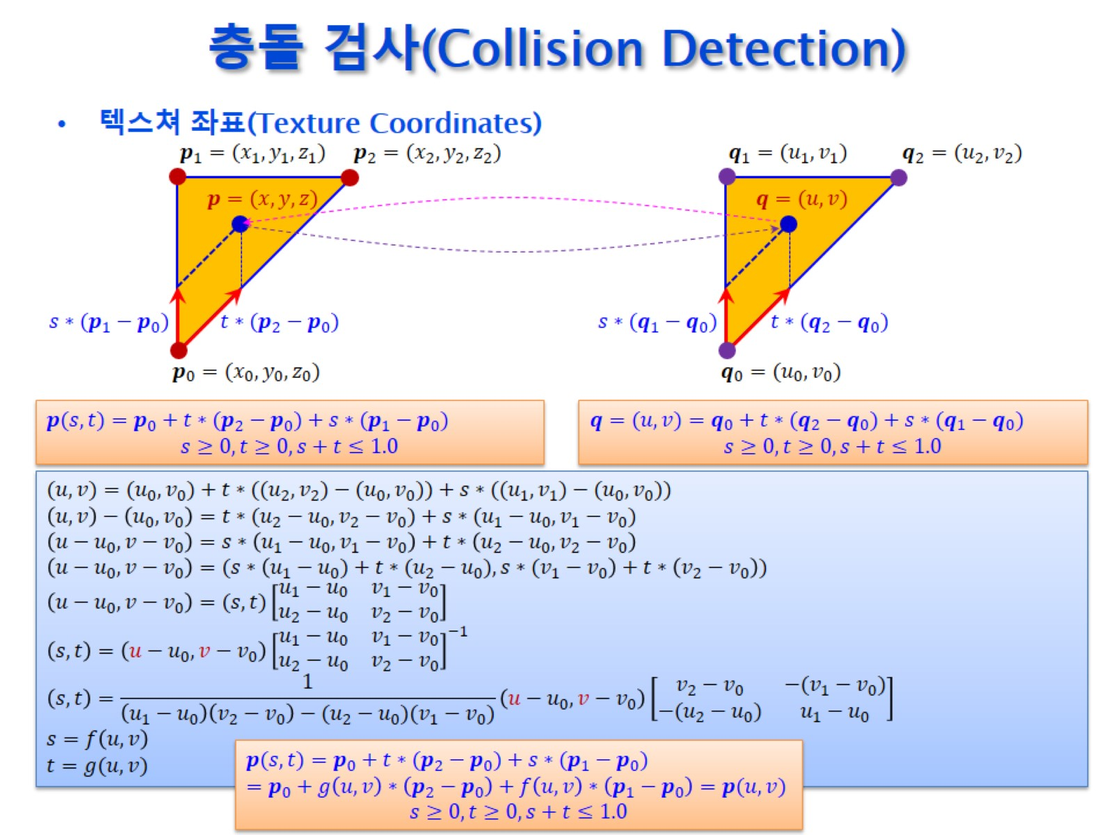
충돌 검사(Collision Detection)

Slide 9
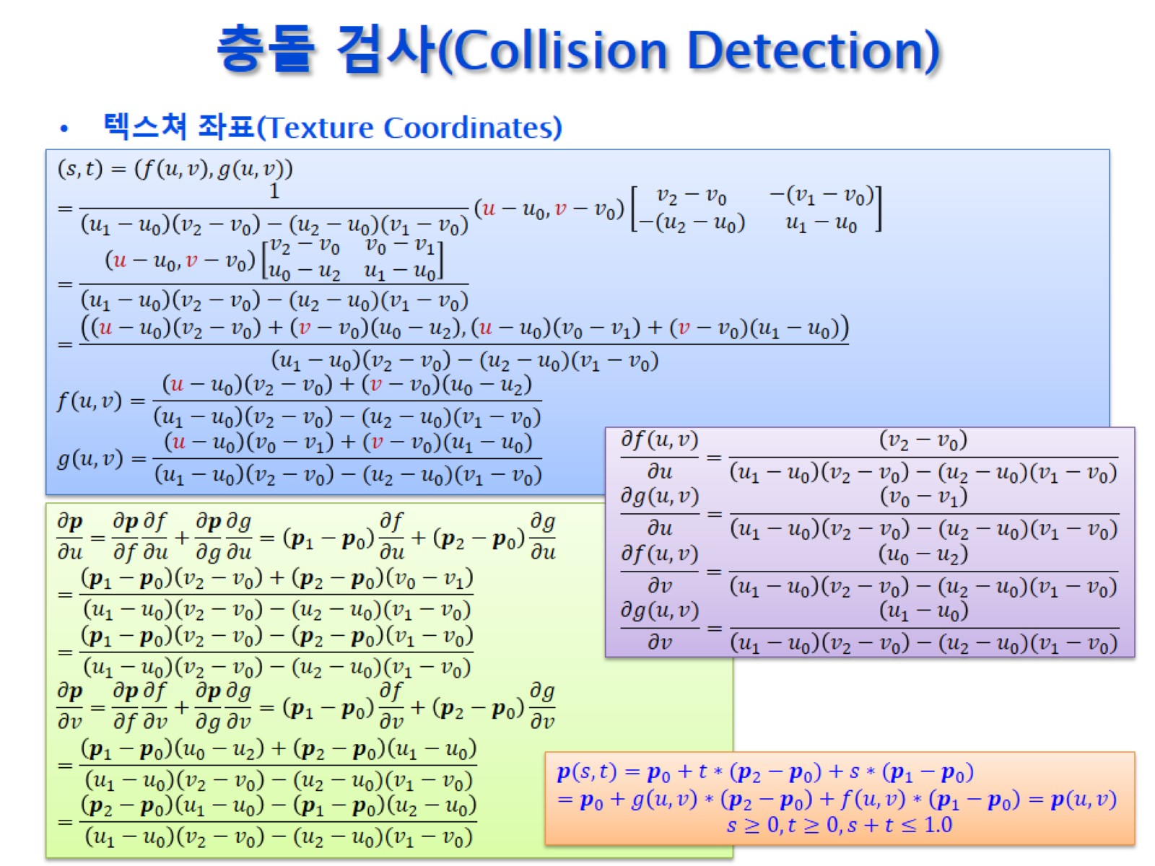
충돌 검사(Collision Detection)

Slide 10
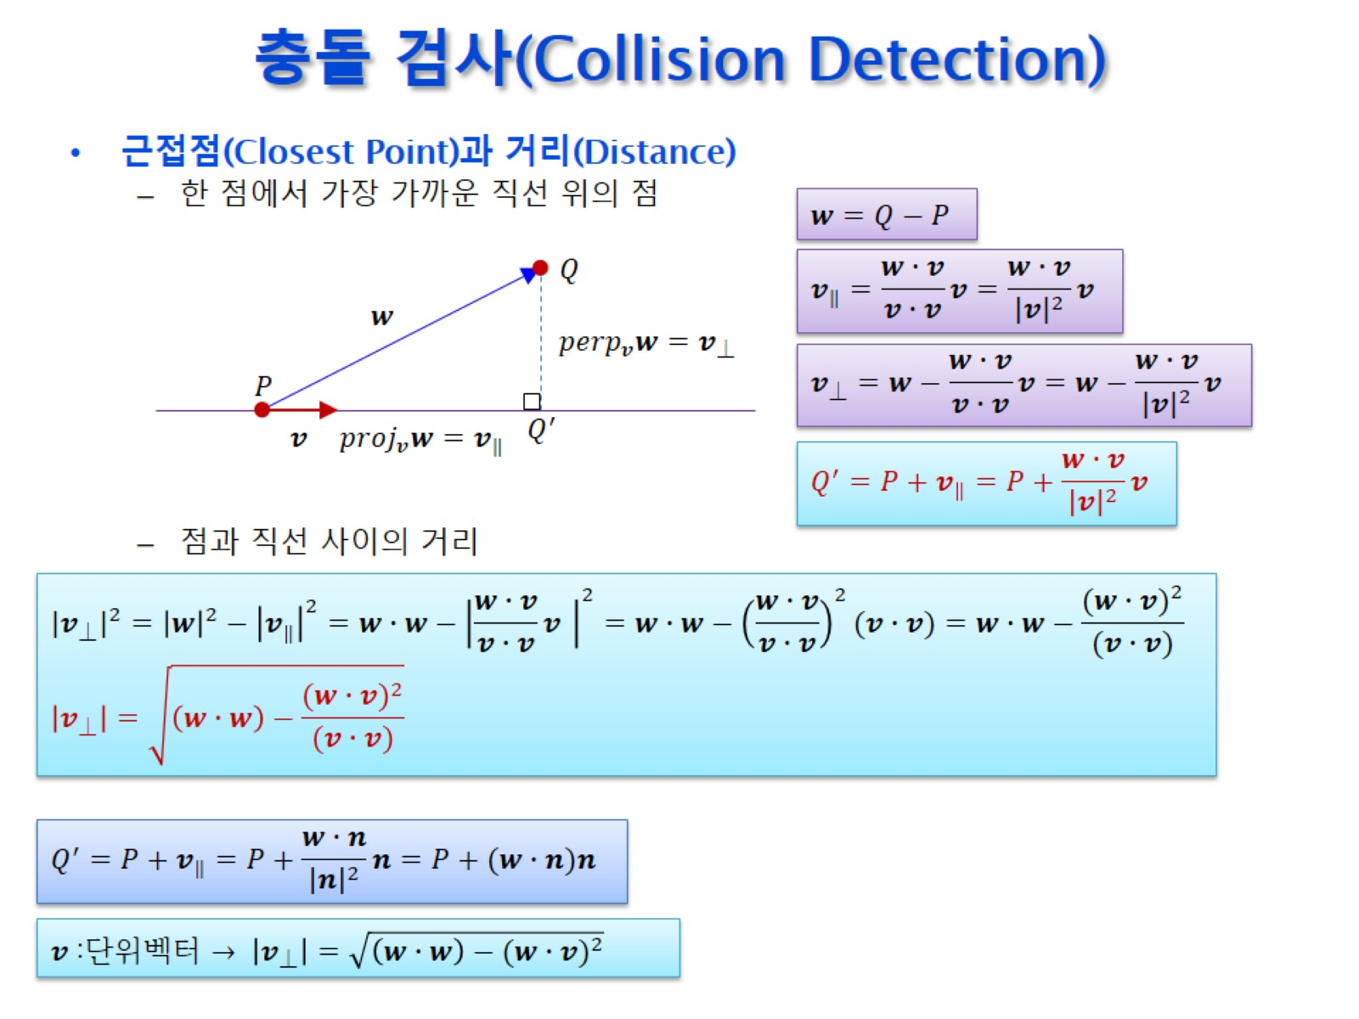
충돌 검사(Collision Detection)

Slide 11
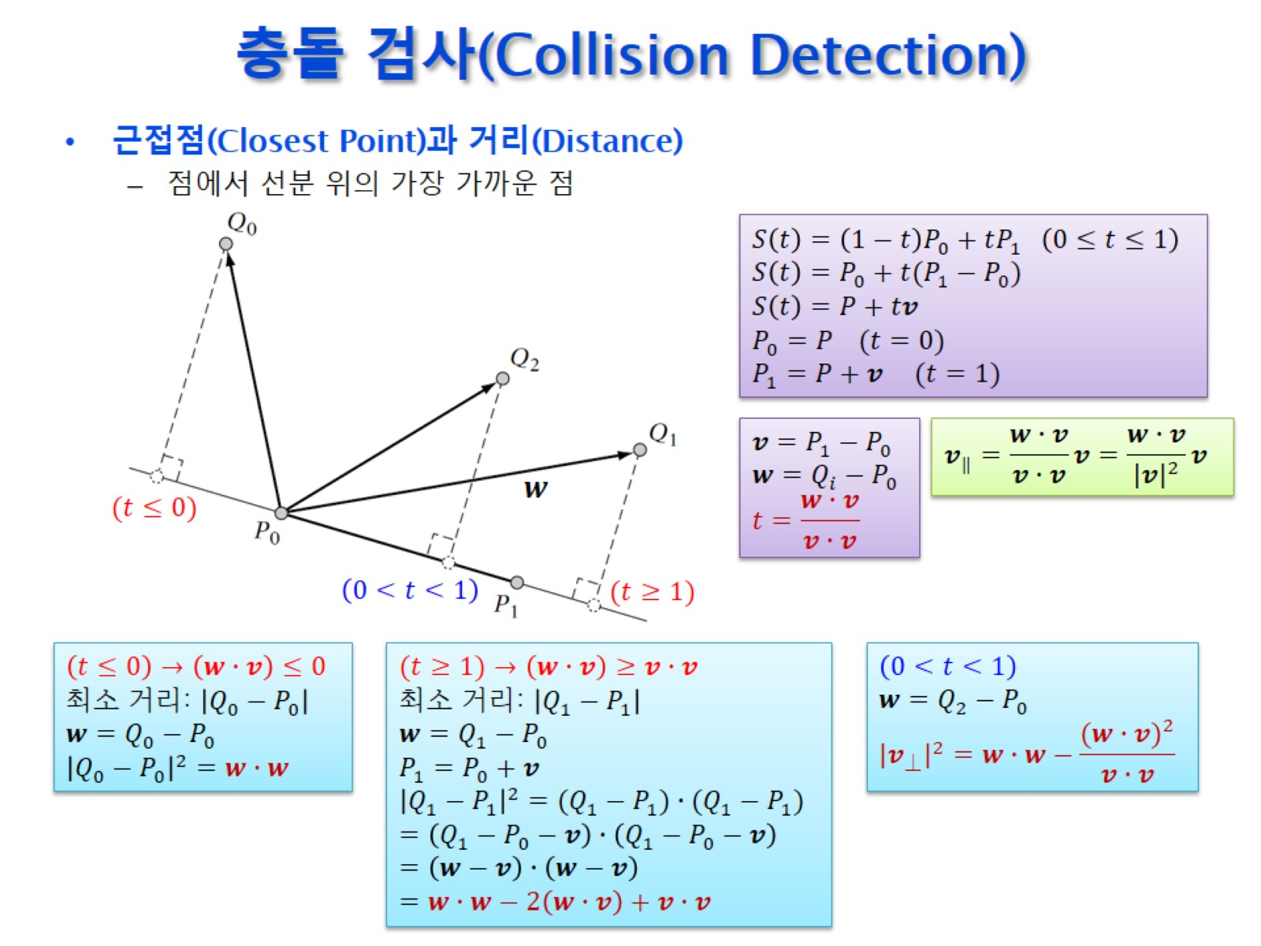
충돌 검사(Collision Detection)

Slide 12
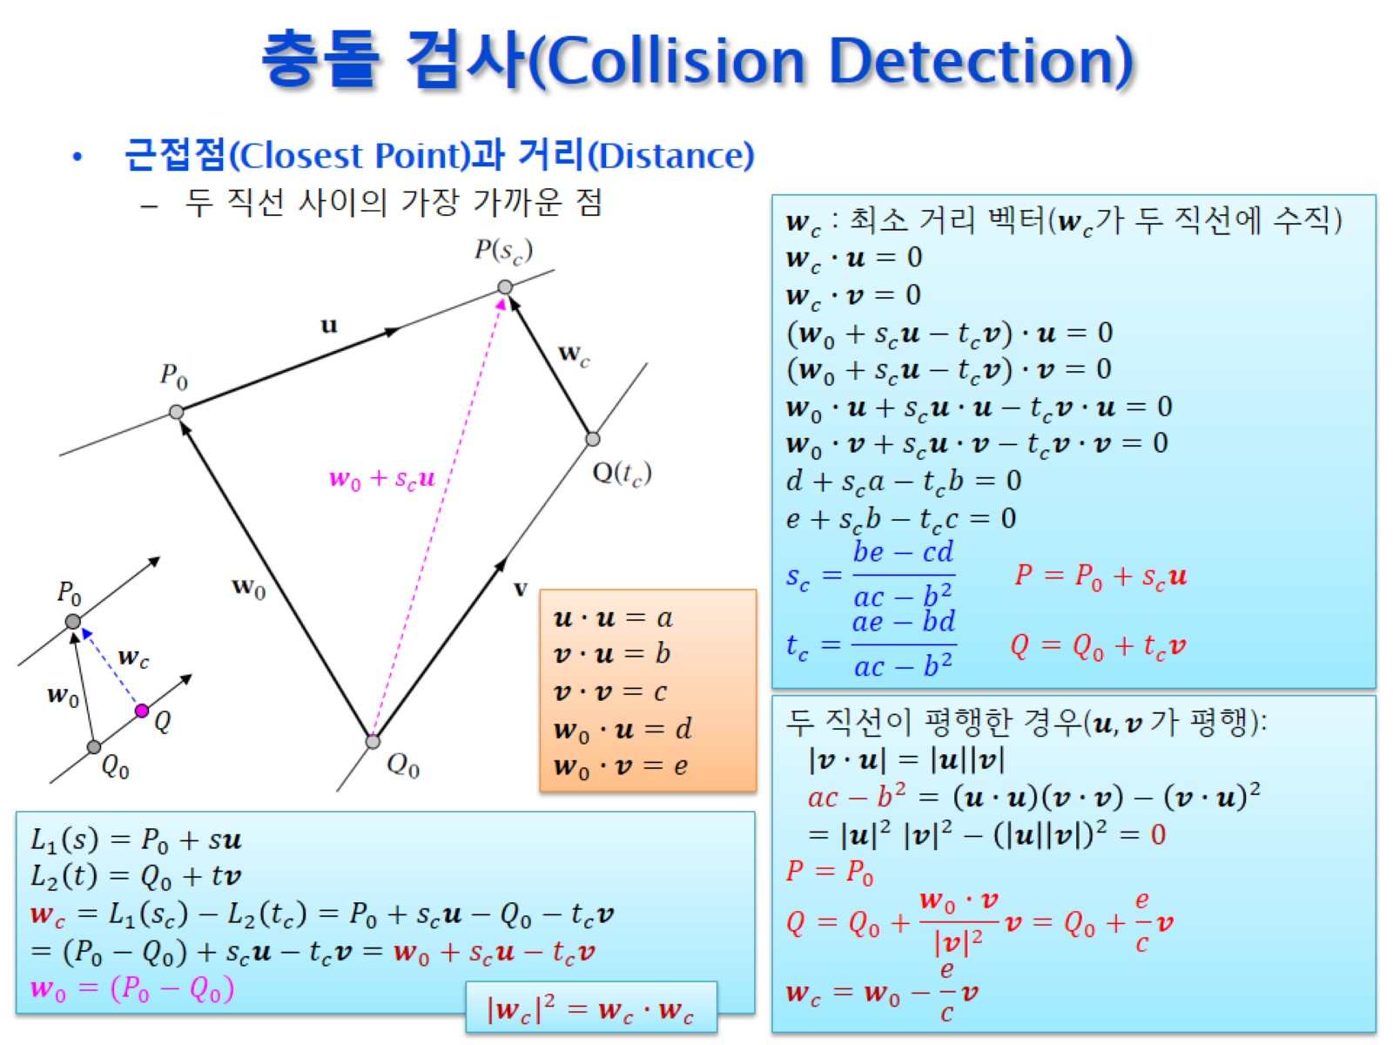
충돌 검사(Collision Detection)

Slide 13
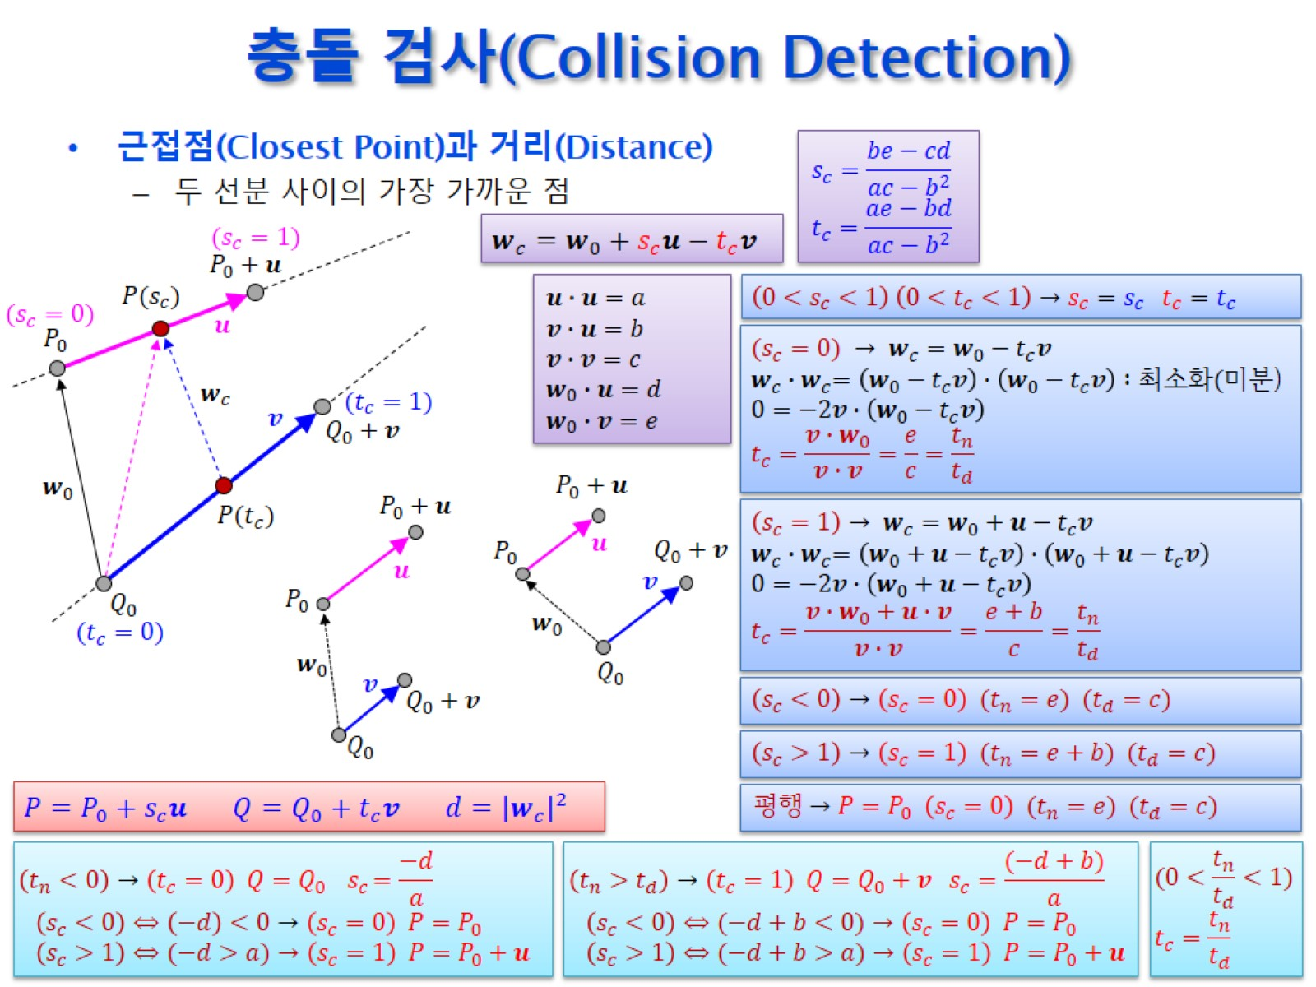
충돌 검사(Collision Detection)

Slide 14
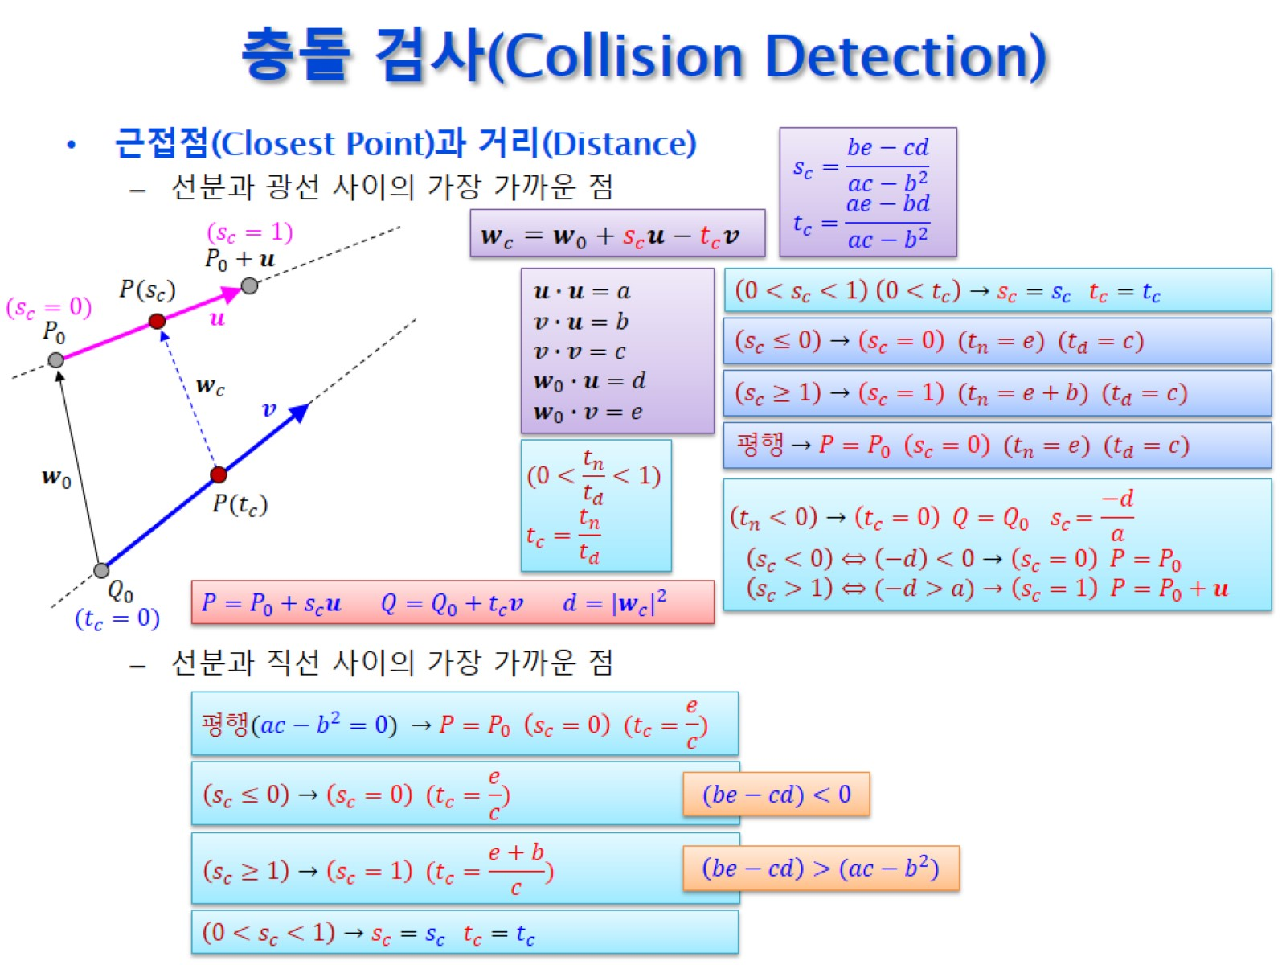
충돌 검사(Collision Detection)

Slide 15
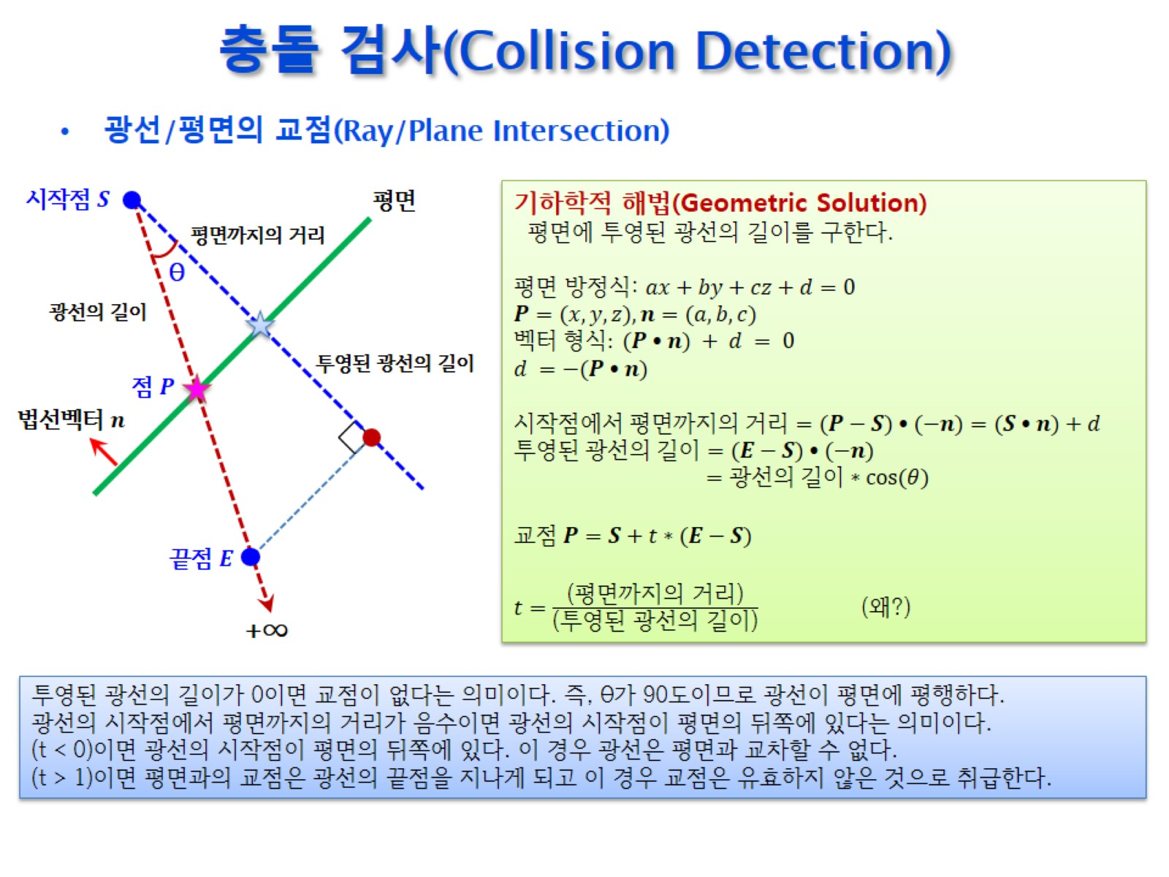
충돌 검사(Collision Detection)

Slide 16
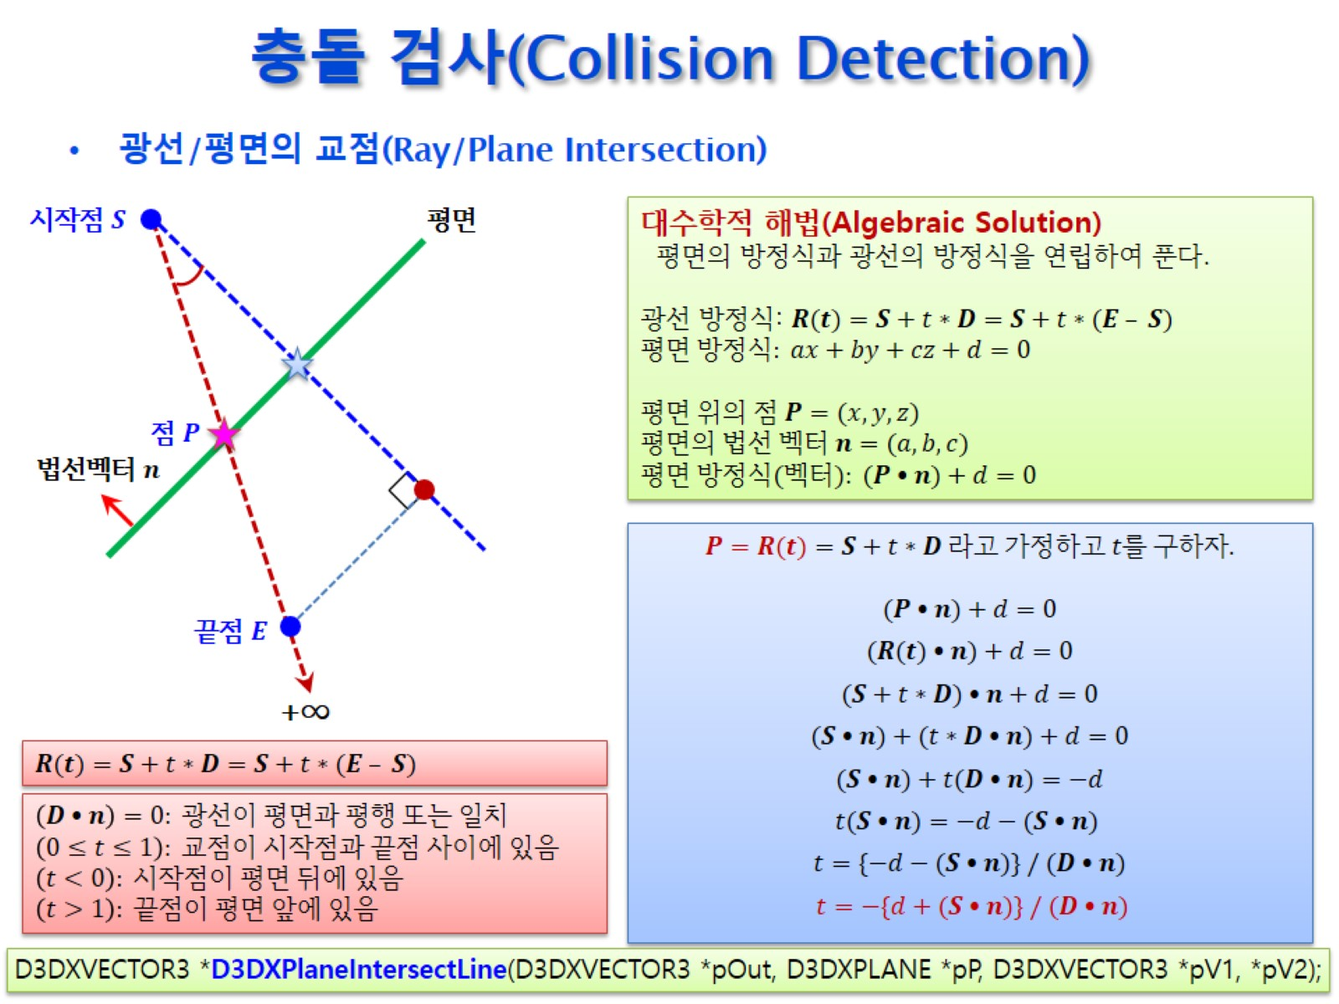
충돌 검사(Collision Detection)

Slide 17
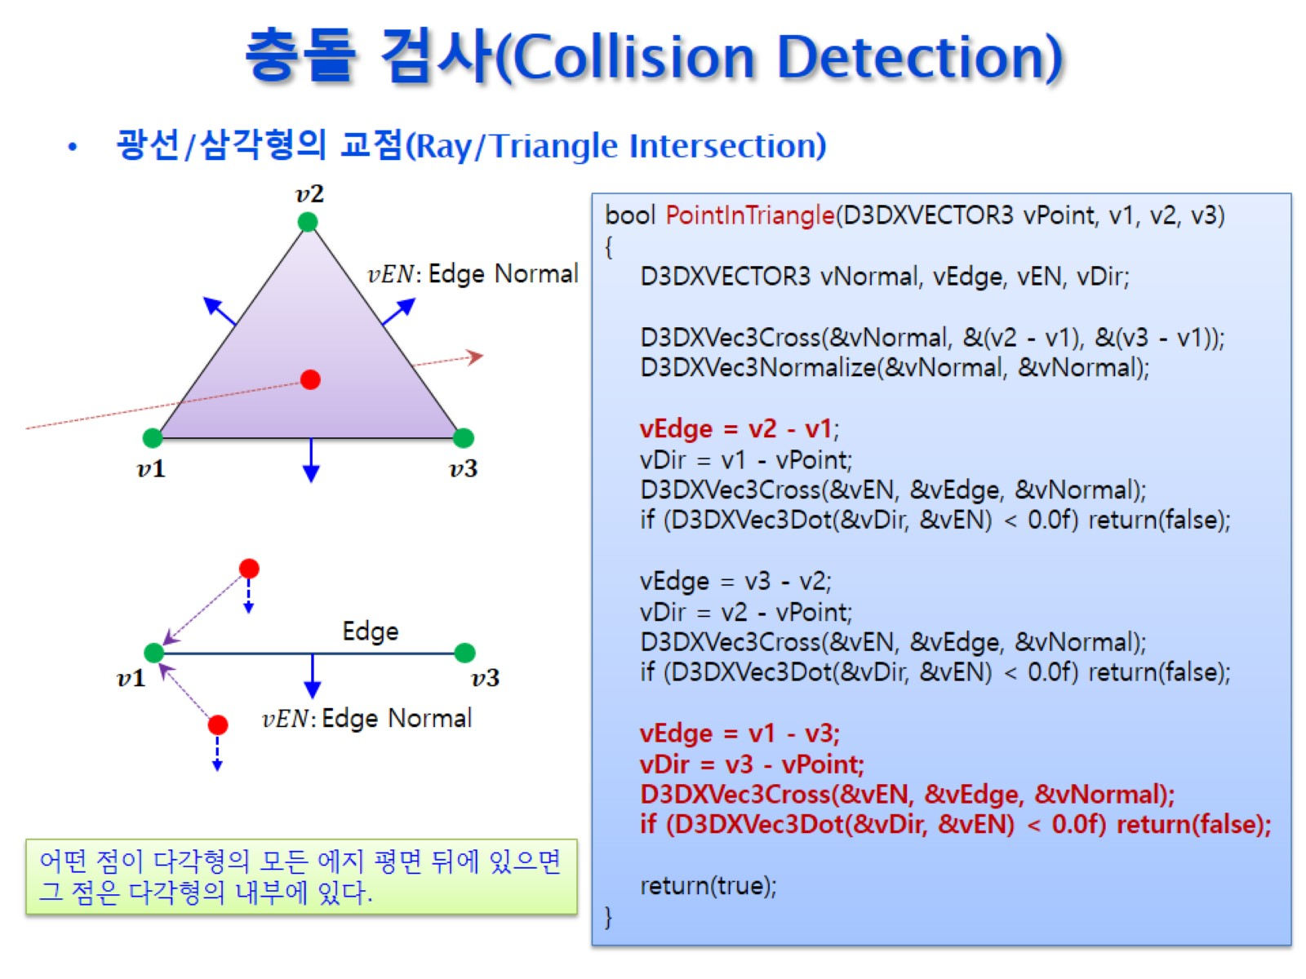
충돌 검사(Collision Detection)

Slide 18
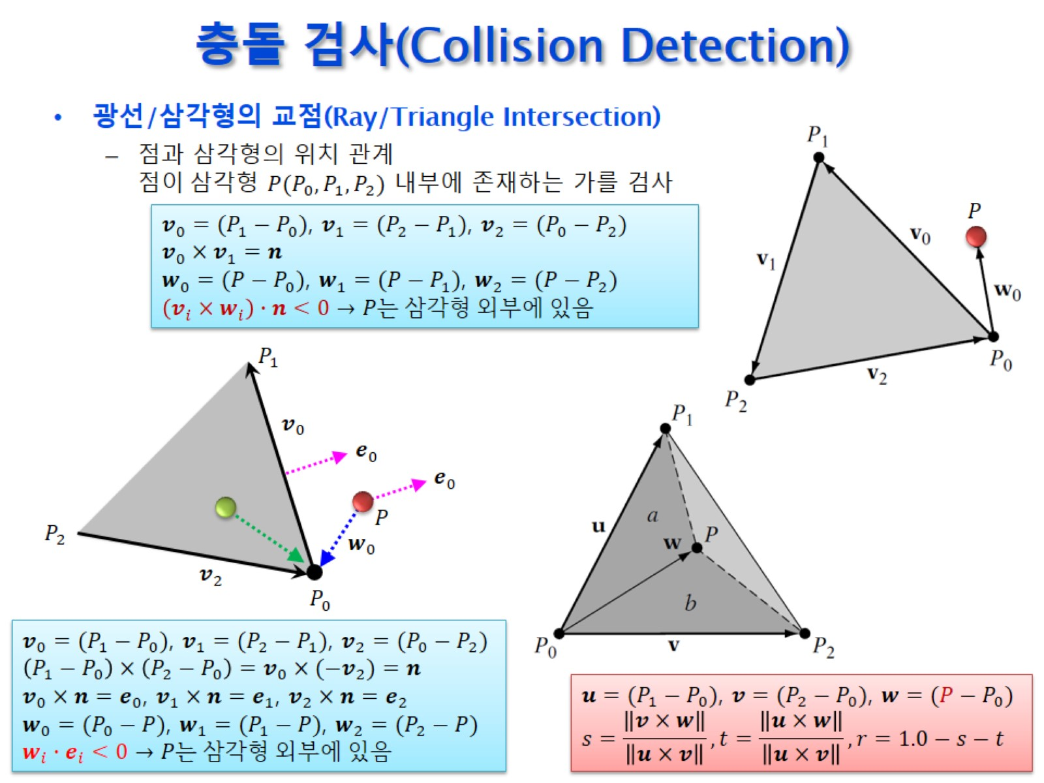
충돌 검사(Collision Detection)

Slide 19
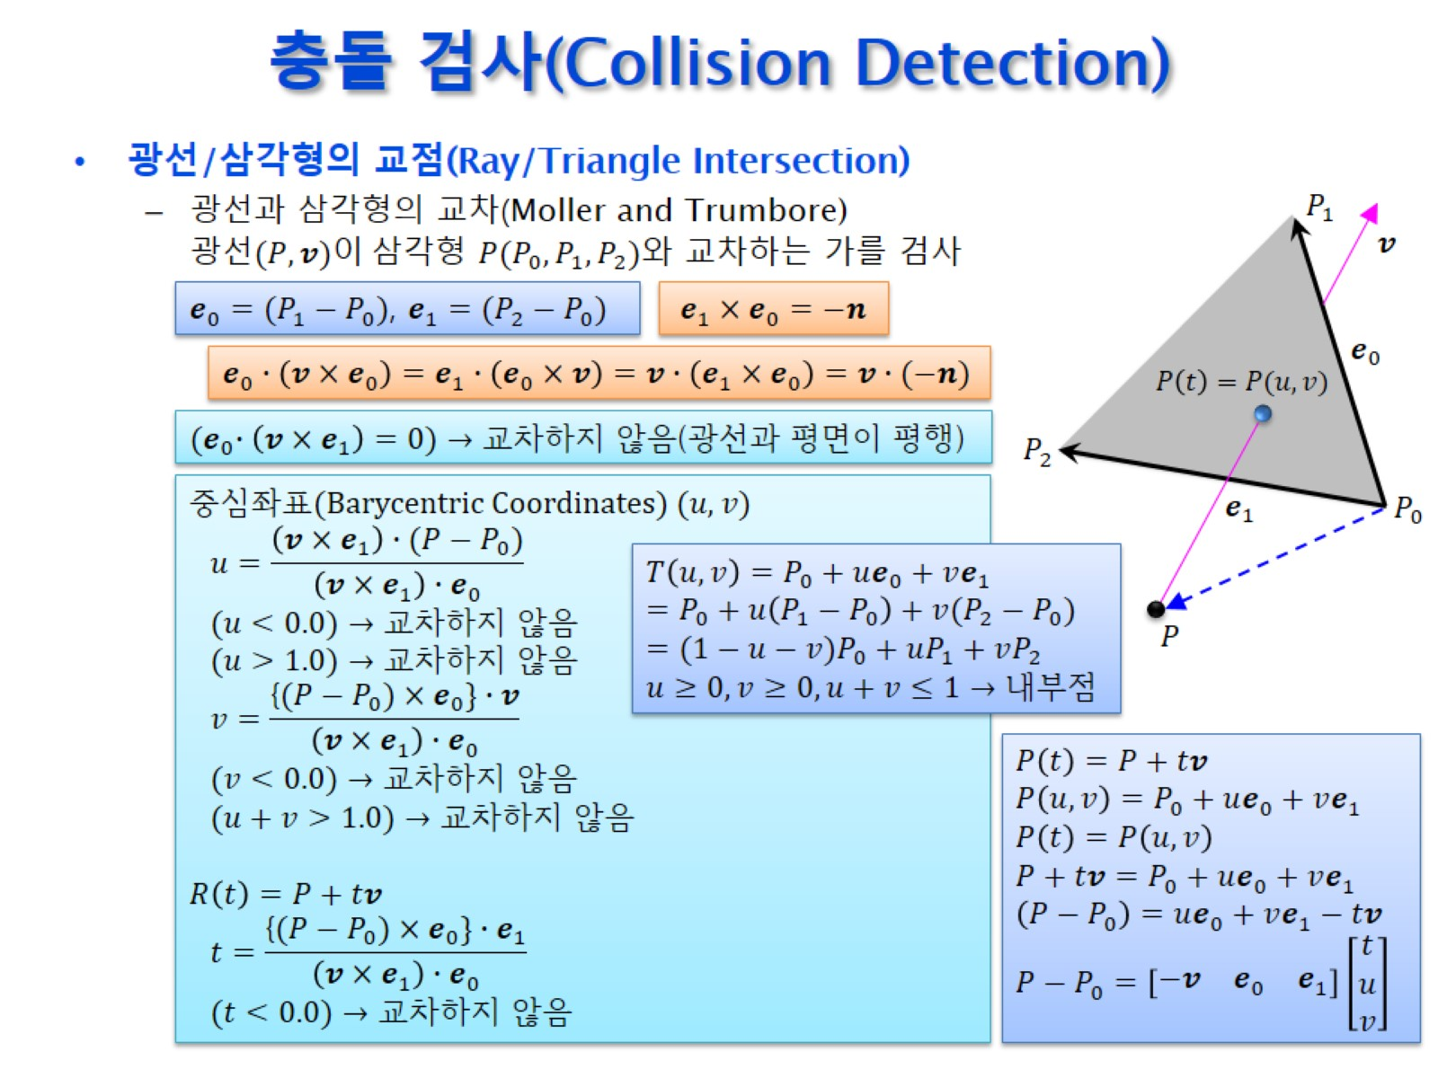
충돌 검사(Collision Detection)

Slide 20
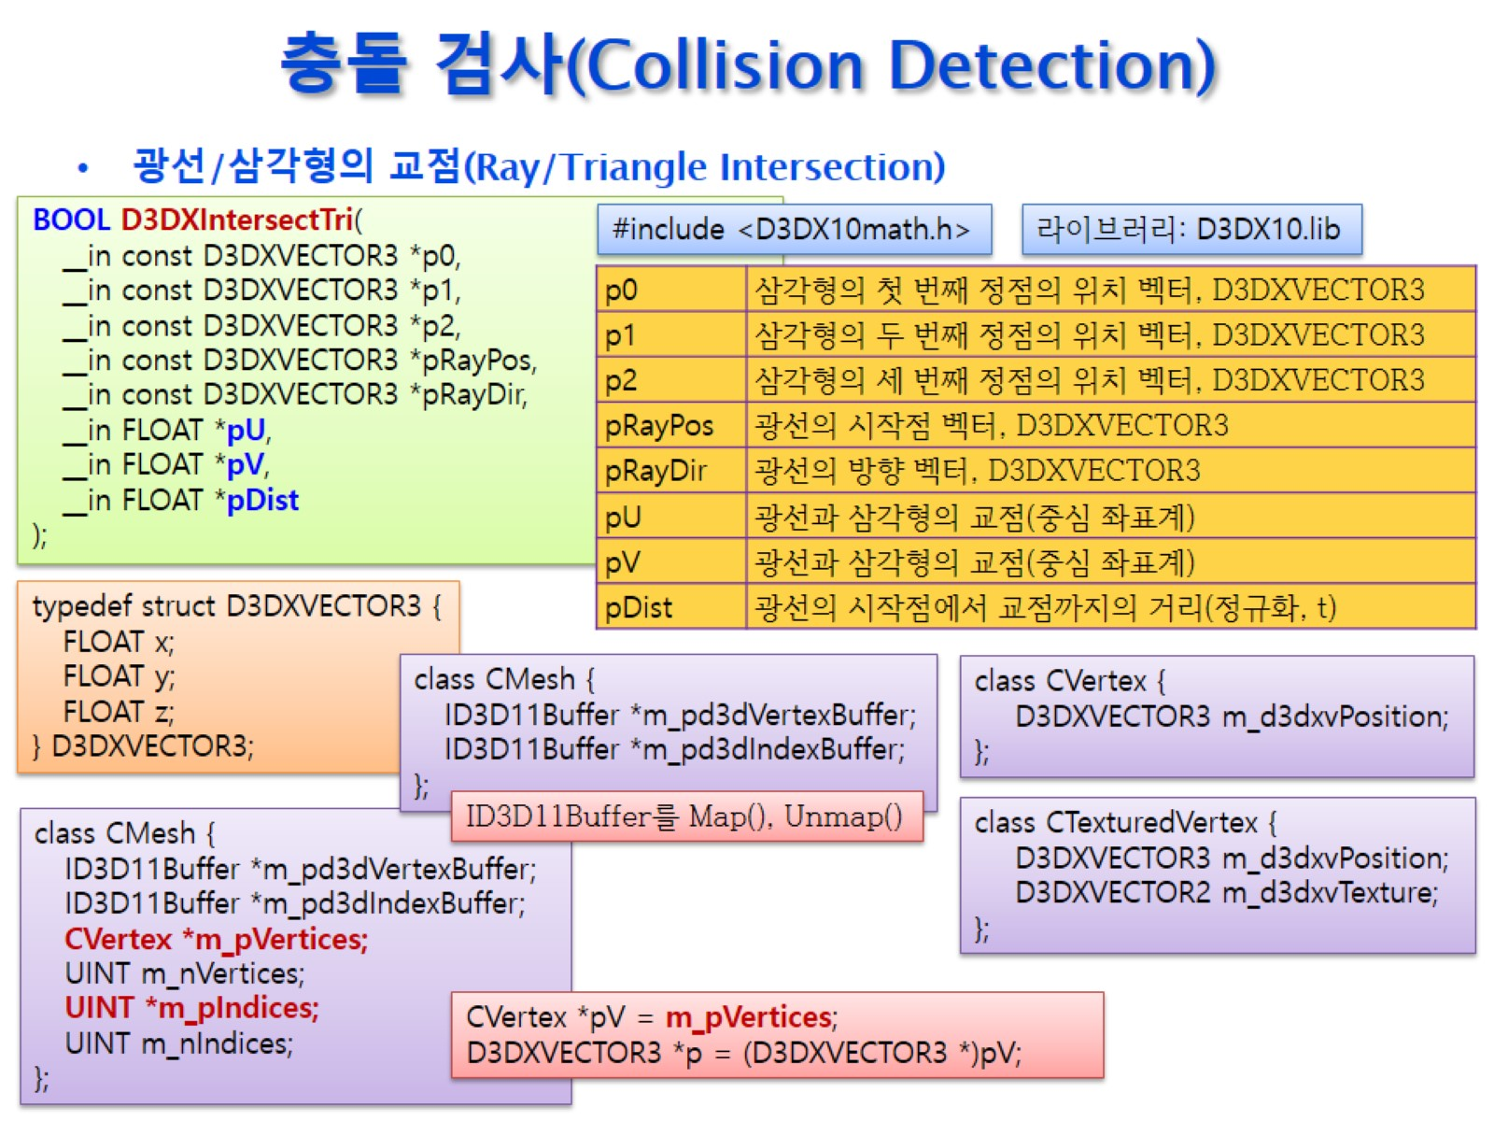
충돌 검사(Collision Detection)

Slide 21
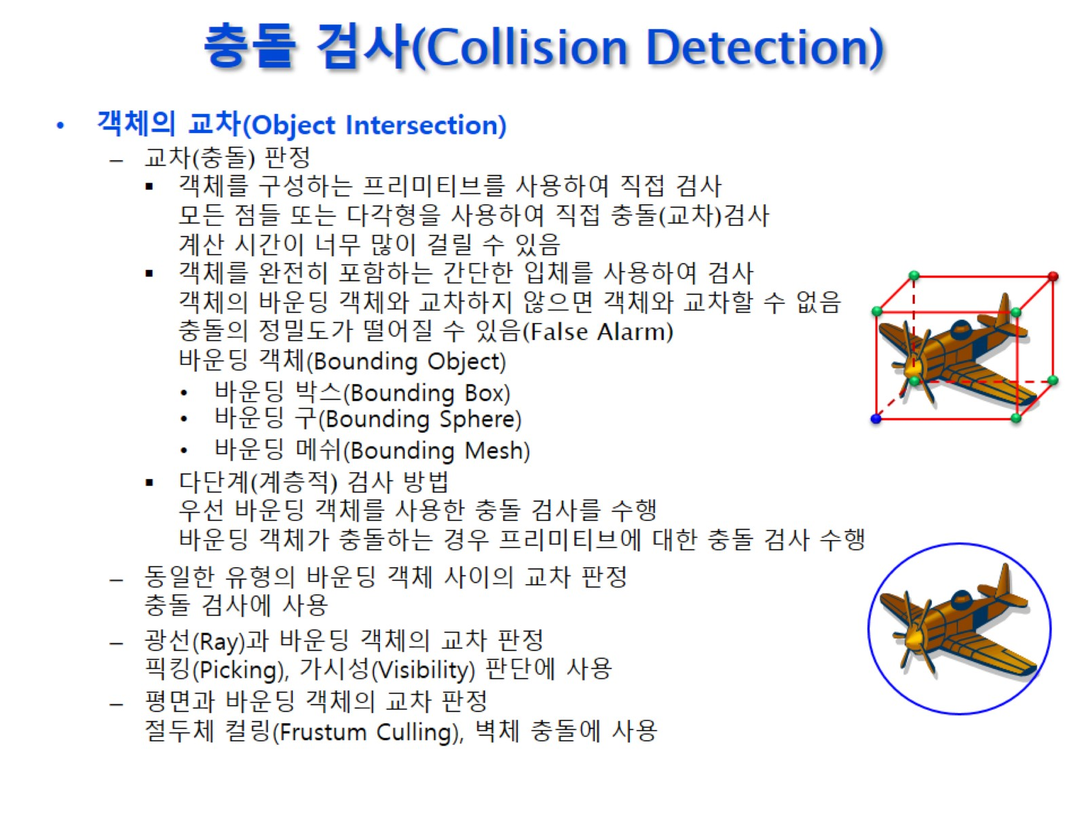
충돌 검사(Collision Detection)

Slide 22
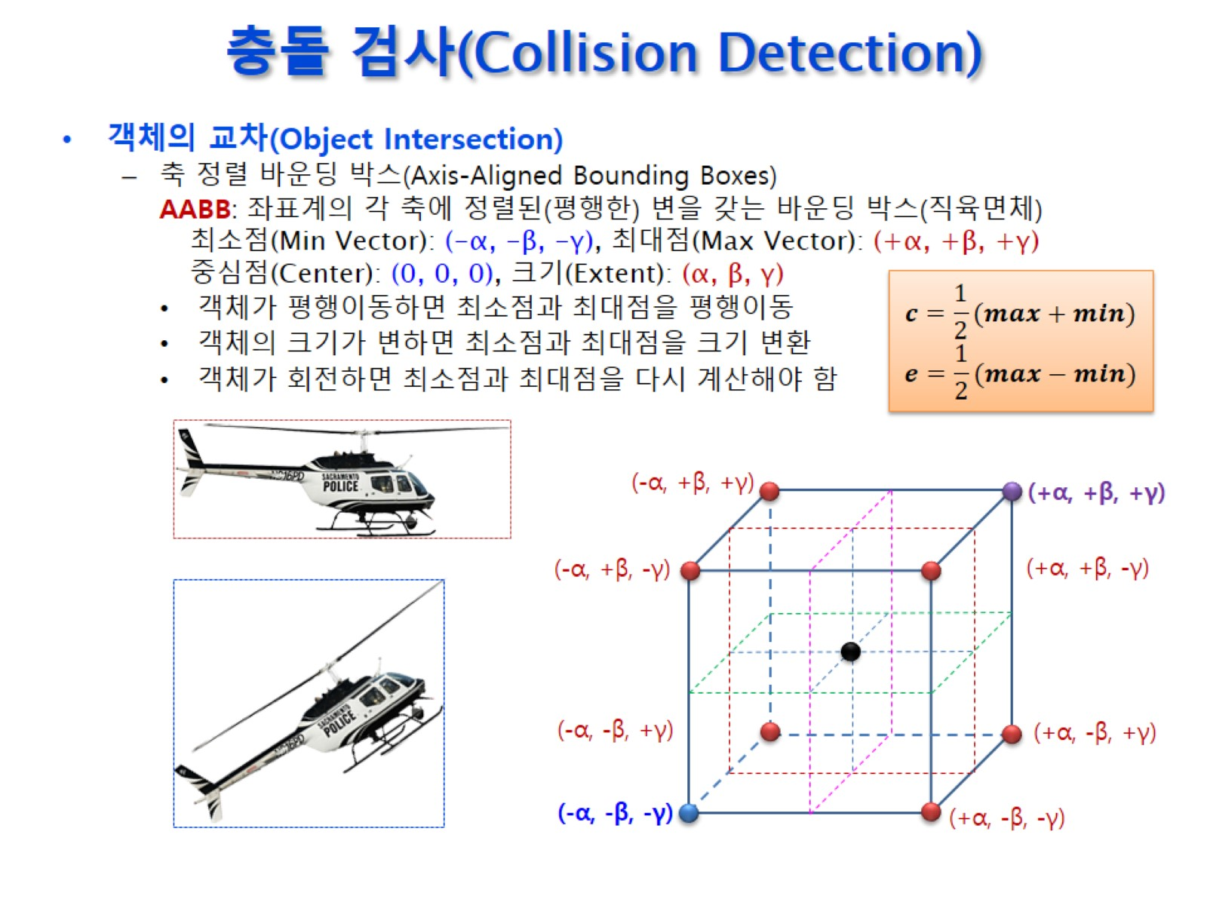
충돌 검사(Collision Detection)

Slide 23
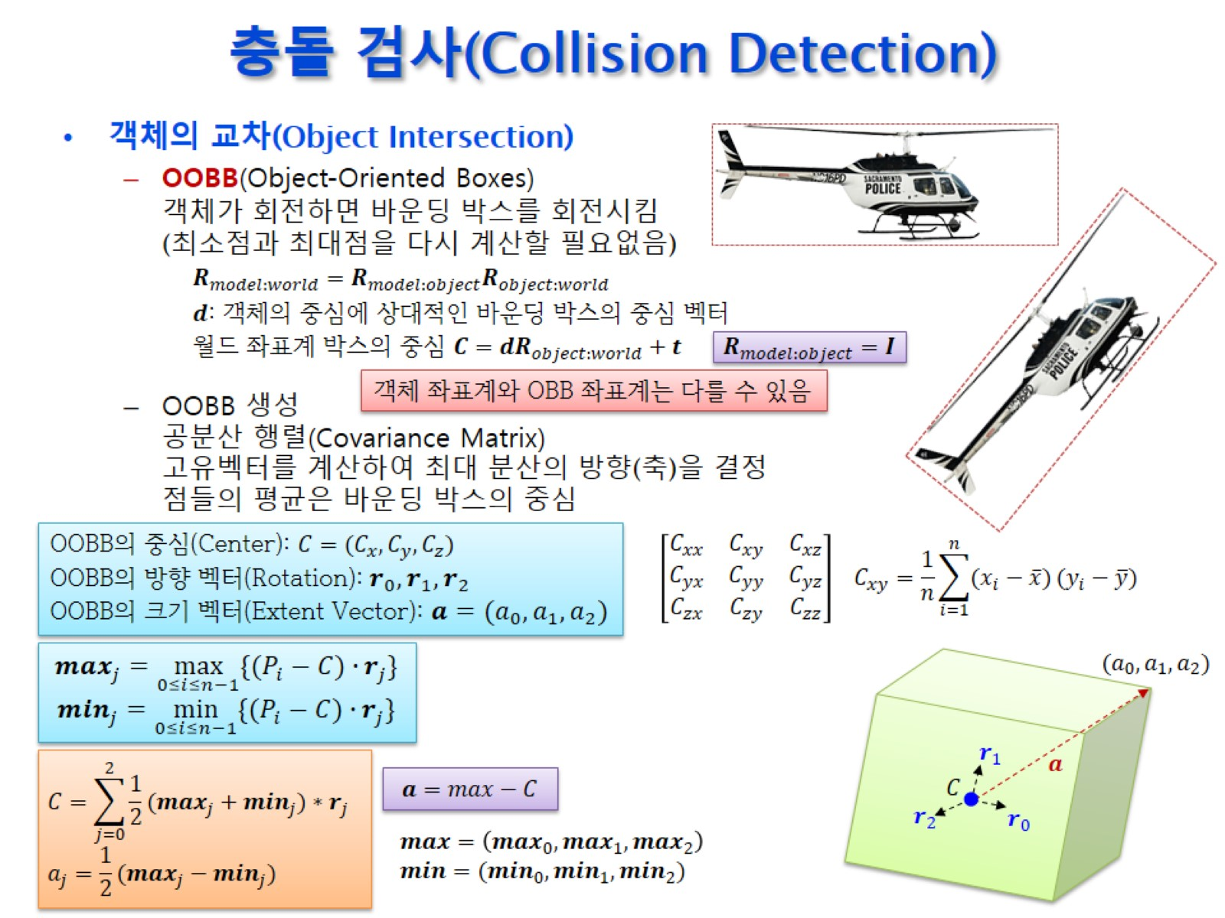
충돌 검사(Collision Detection)

Slide 24
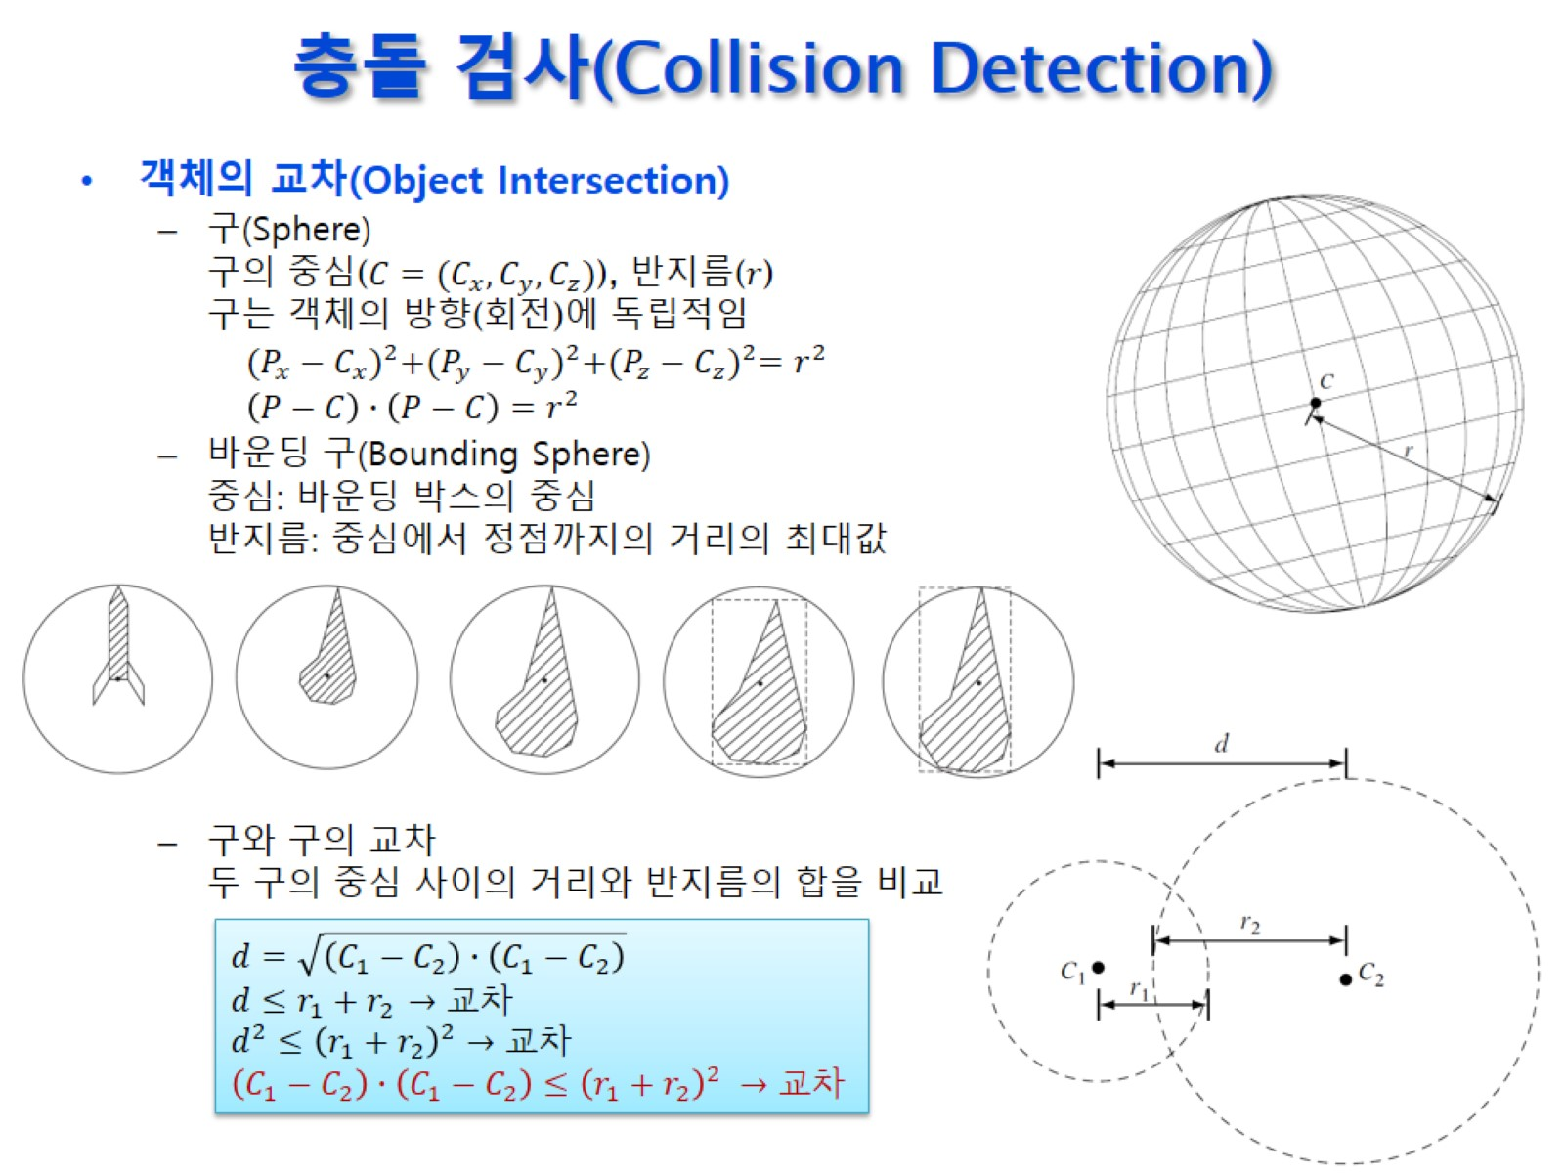
충돌 검사(Collision Detection)

Slide 25
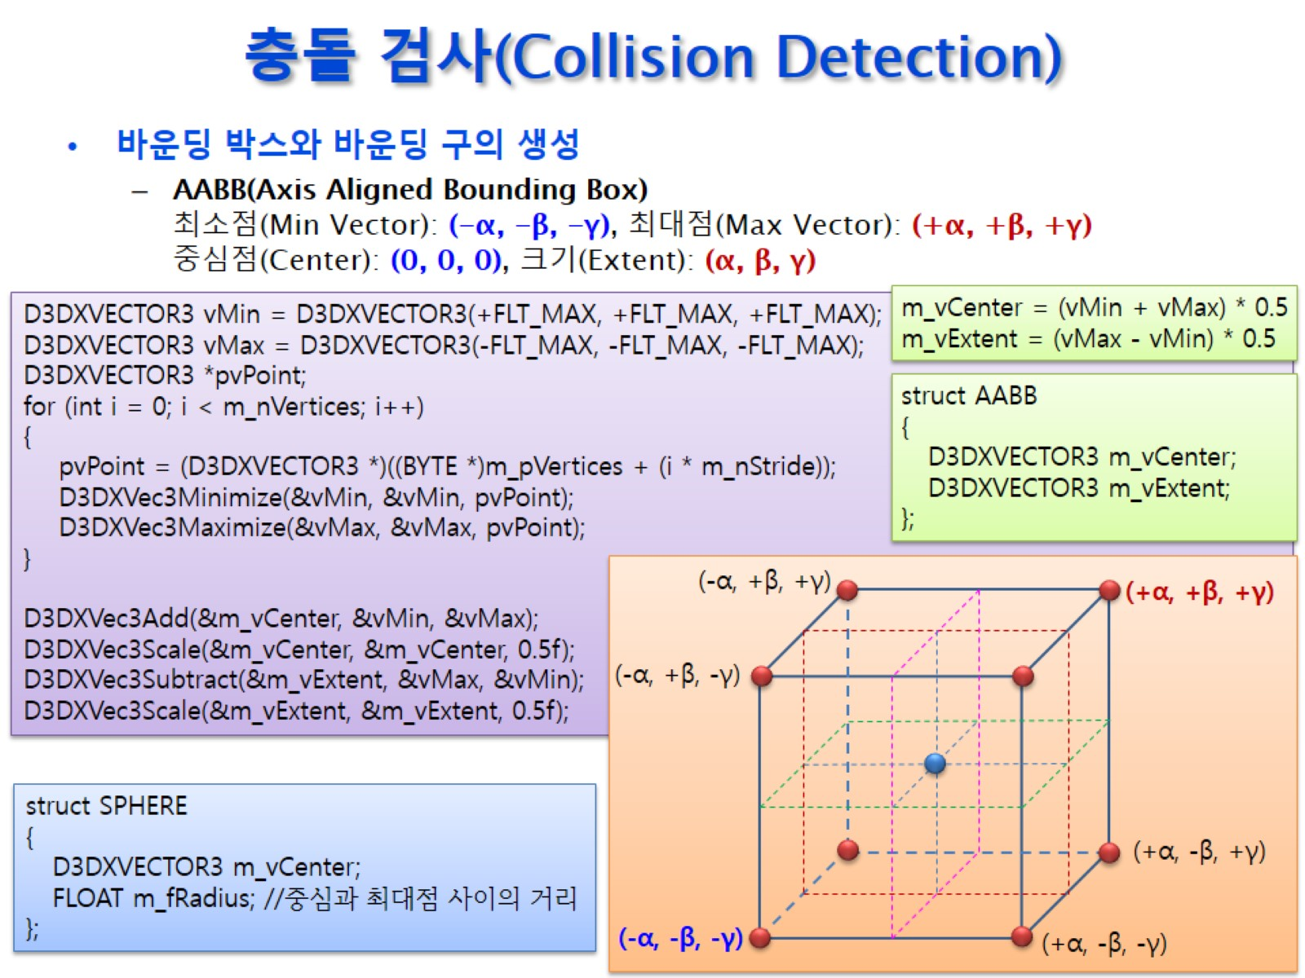
충돌 검사(Collision Detection)

Slide 26
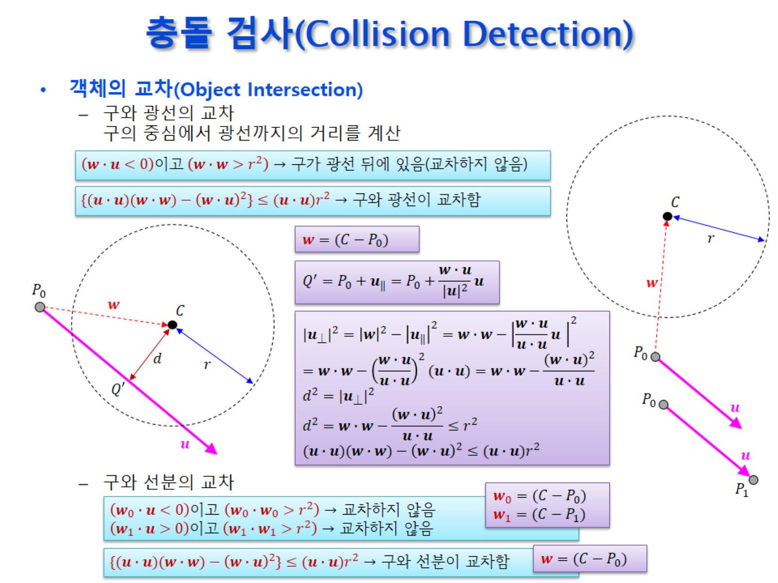
충돌 검사(Collision Detection)

Slide 27
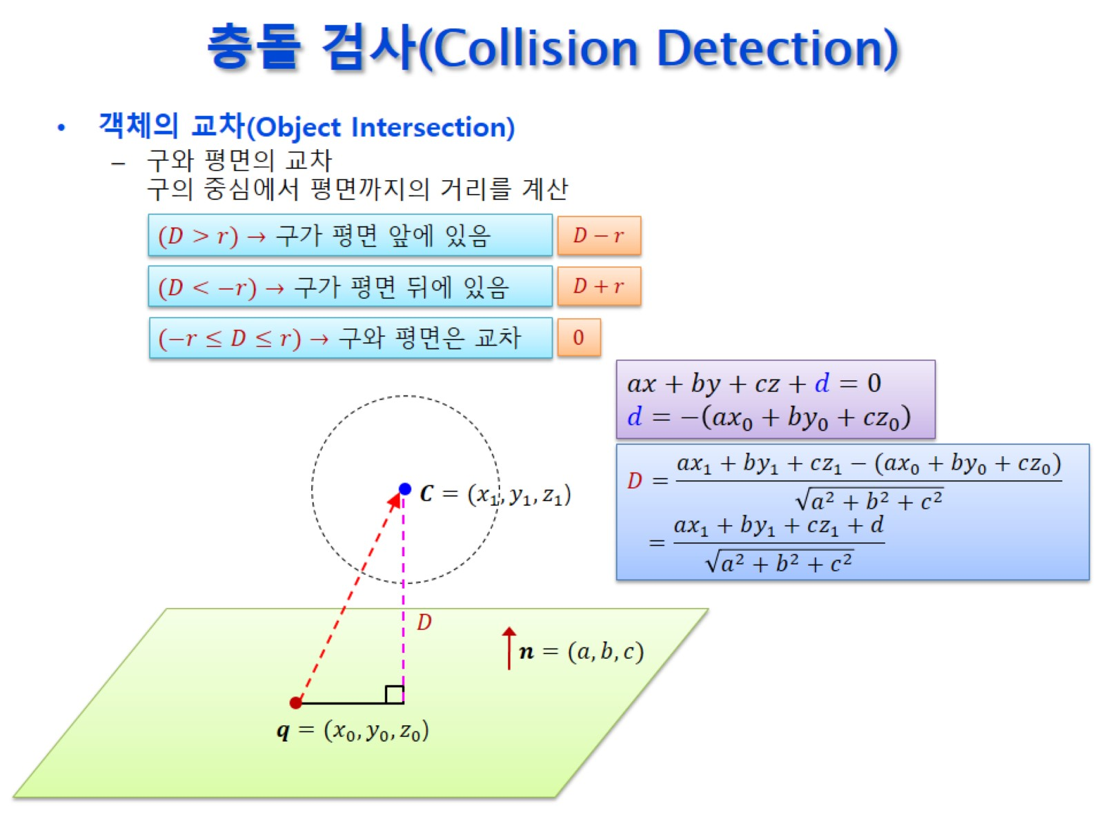
충돌 검사(Collision Detection)

Slide 28
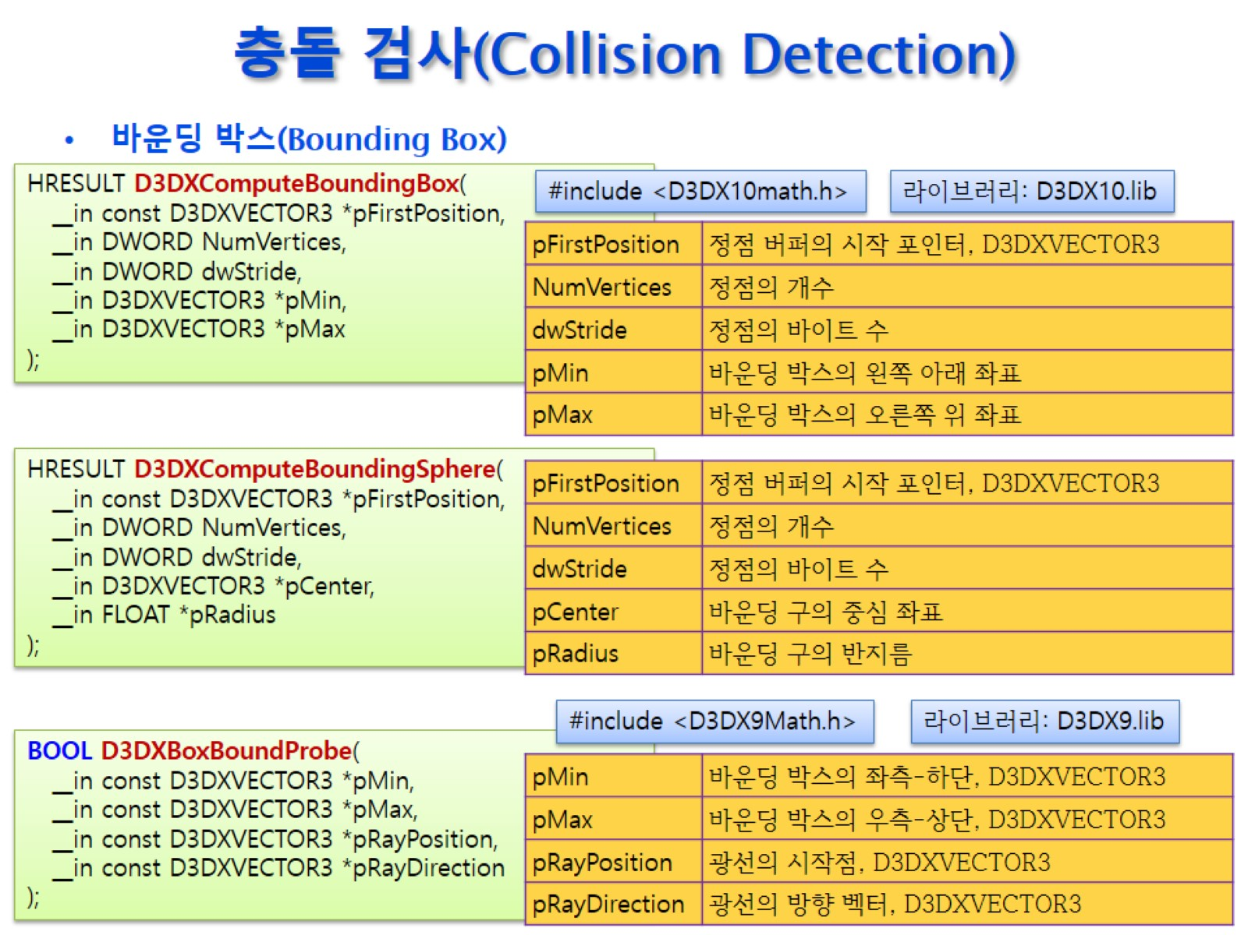
충돌 검사(Collision Detection)

Slide 29
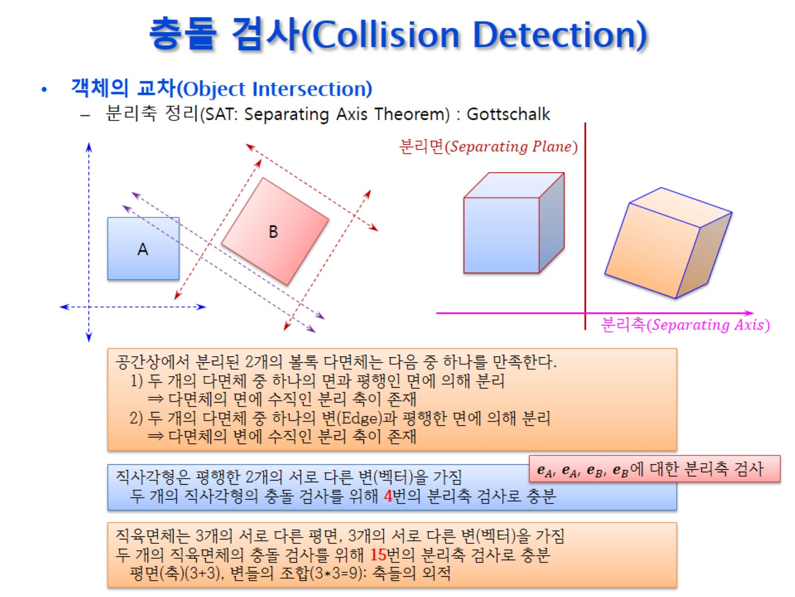
충돌 검사(Collision Detection)

Slide 30
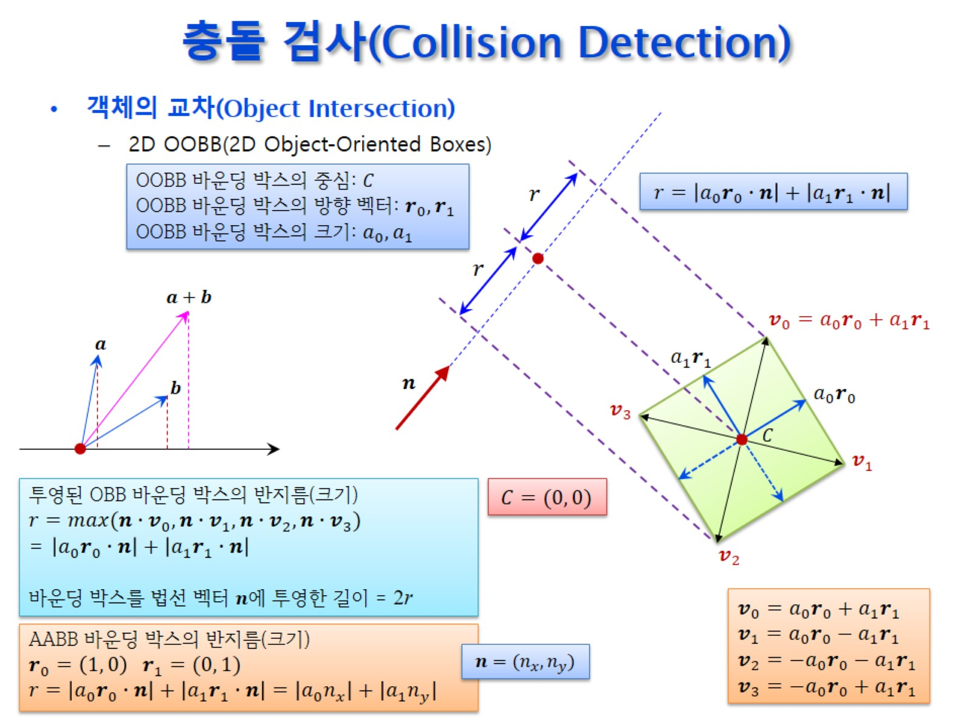
충돌 검사(Collision Detection)

Slide 31
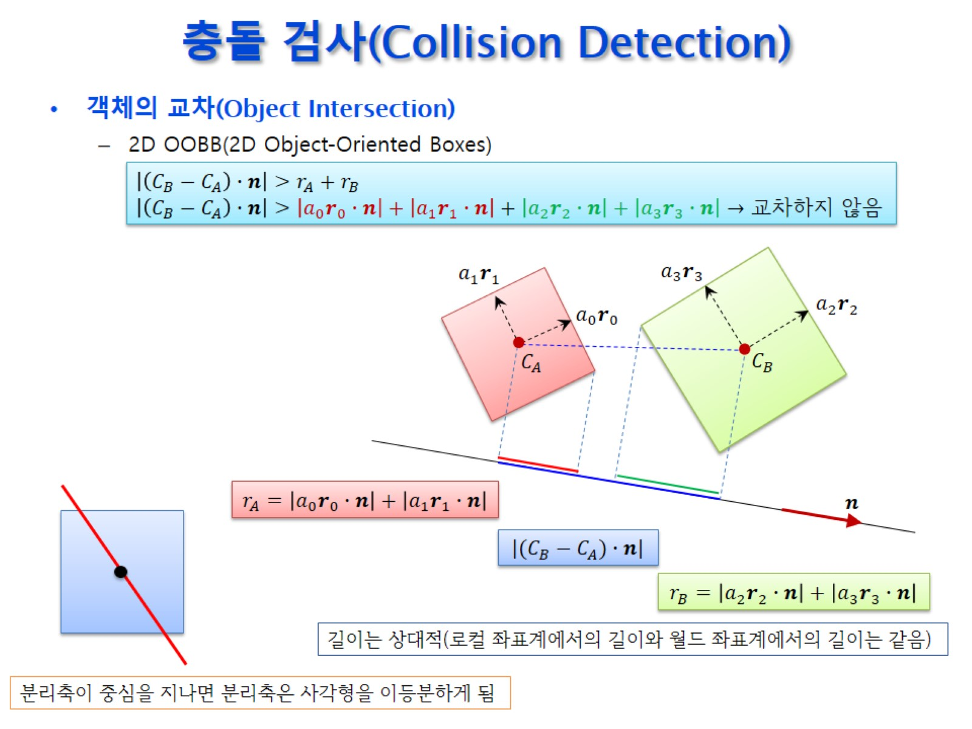
충돌 검사(Collision Detection)

Slide 32
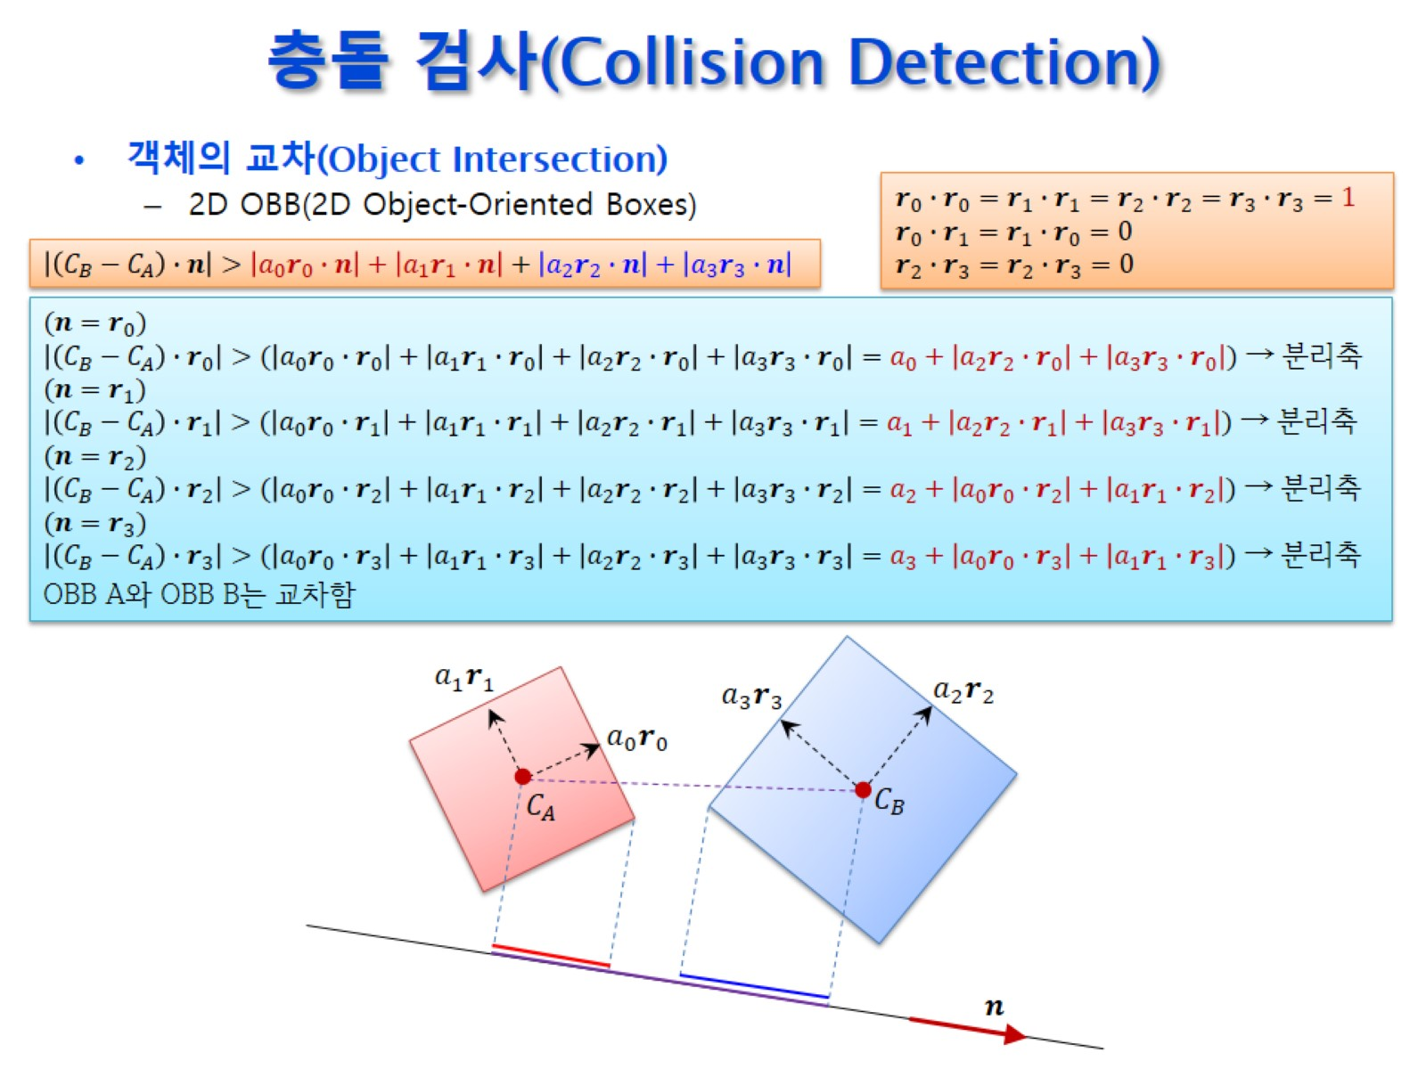
충돌 검사(Collision Detection)

Slide 33
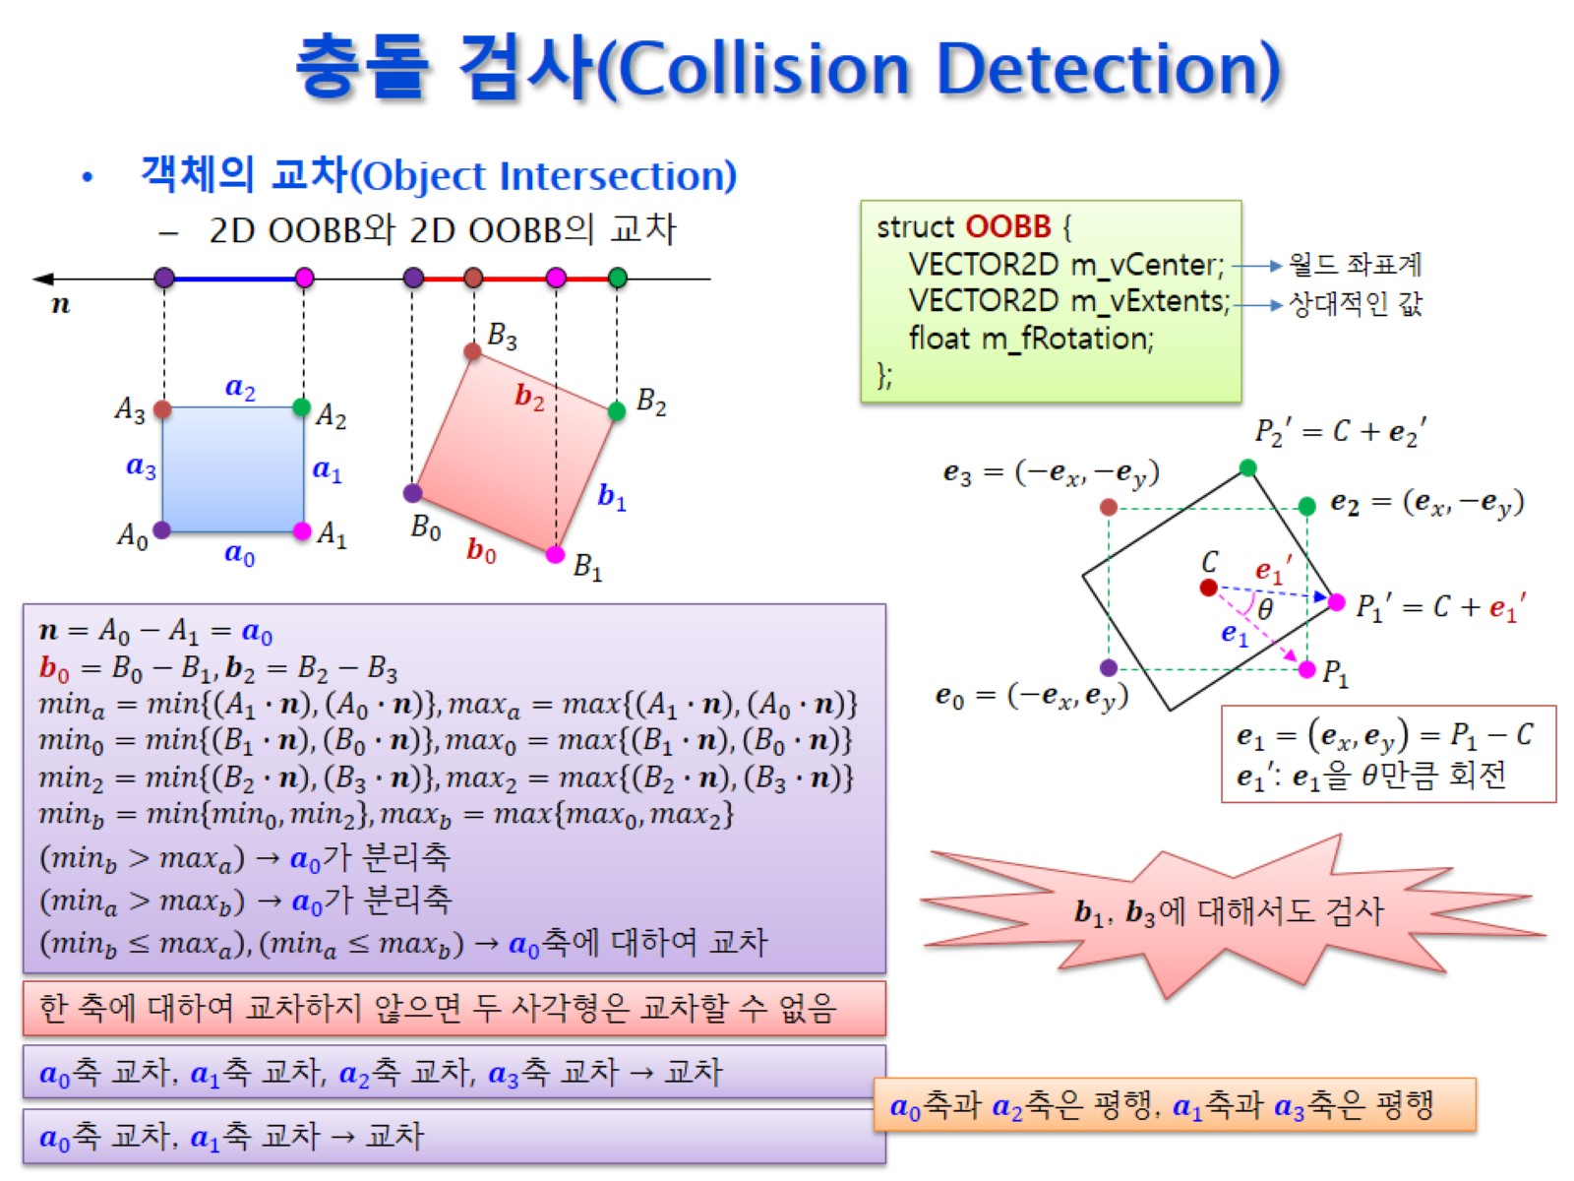
충돌 검사(Collision Detection)

Slide 34
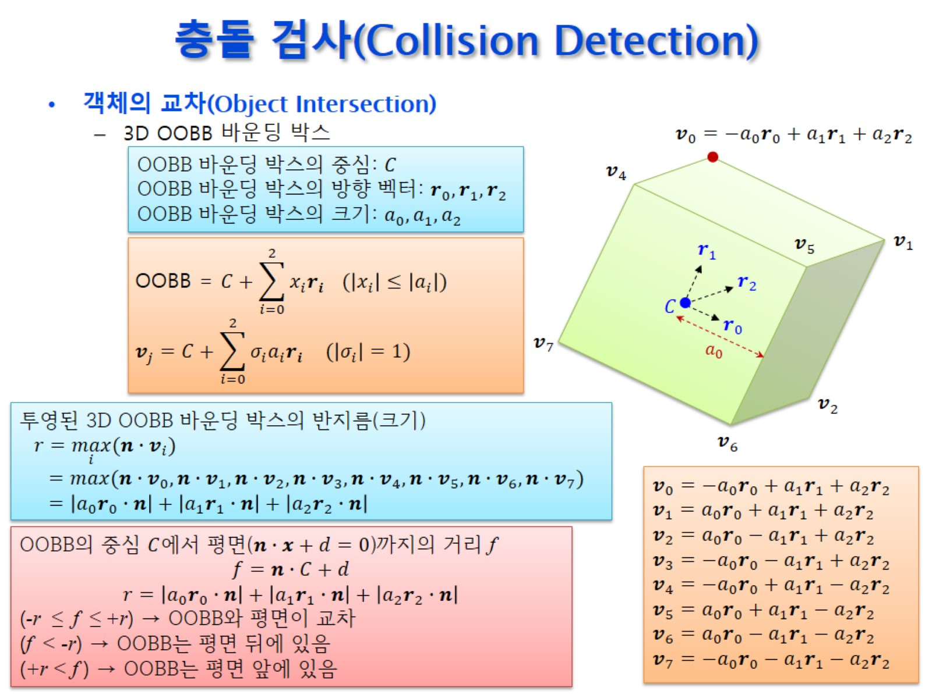
충돌 검사(Collision Detection)

Slide 35
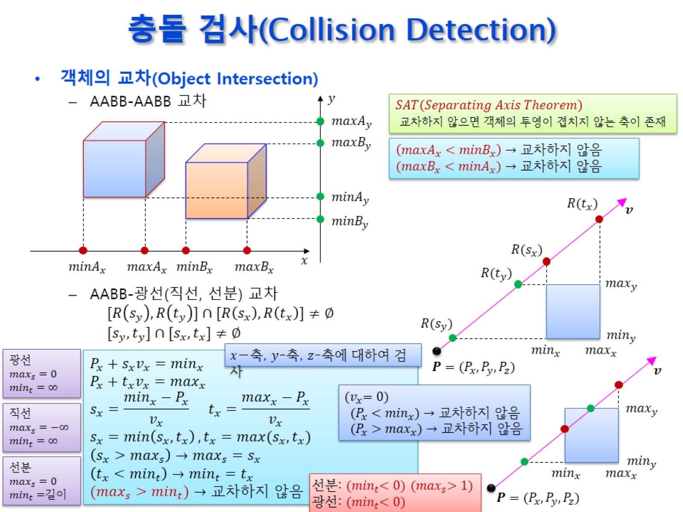
충돌 검사(Collision Detection)

Slide 36
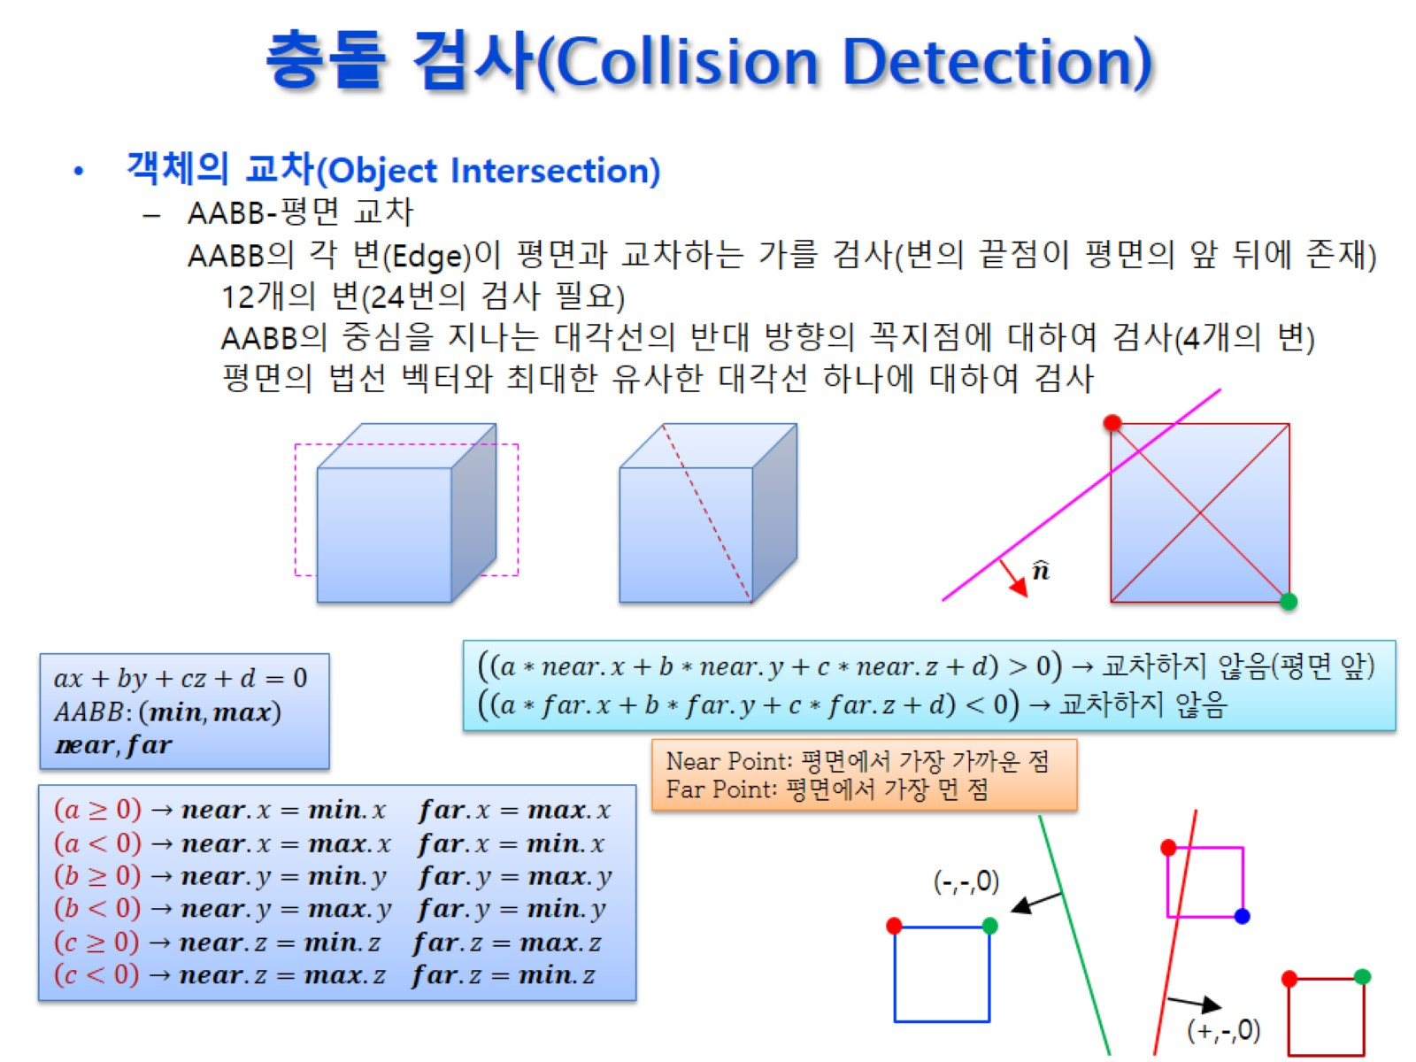
충돌 검사(Collision Detection)

Slide 37
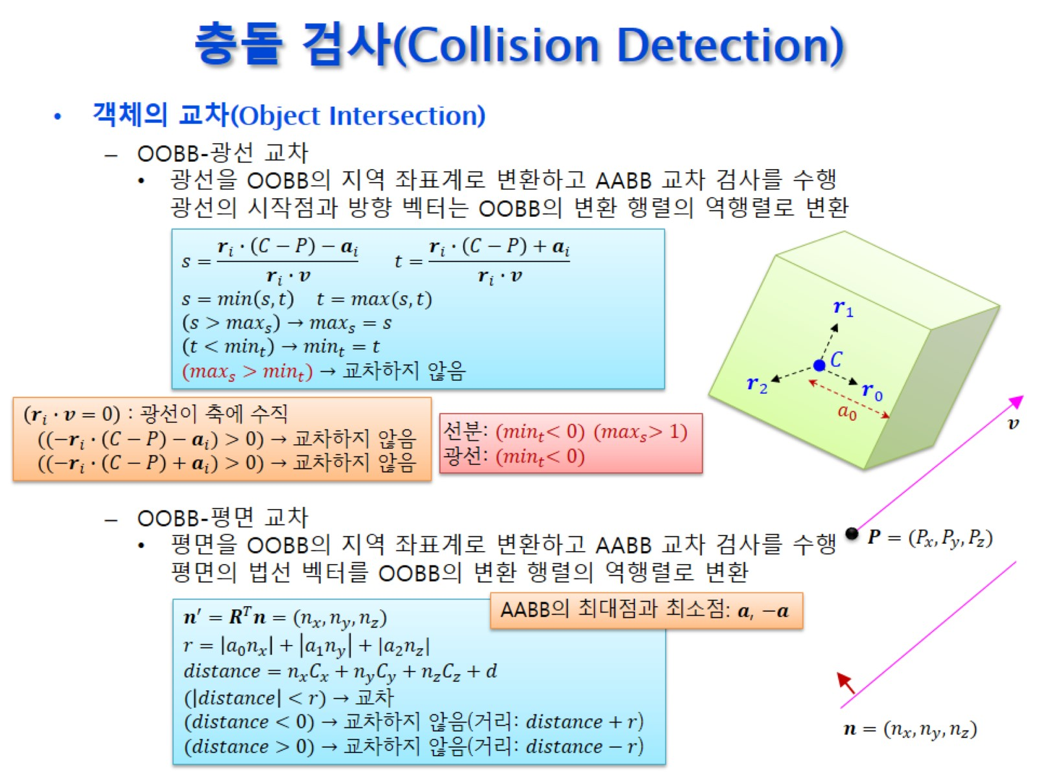
충돌 검사(Collision Detection)

Slide 38
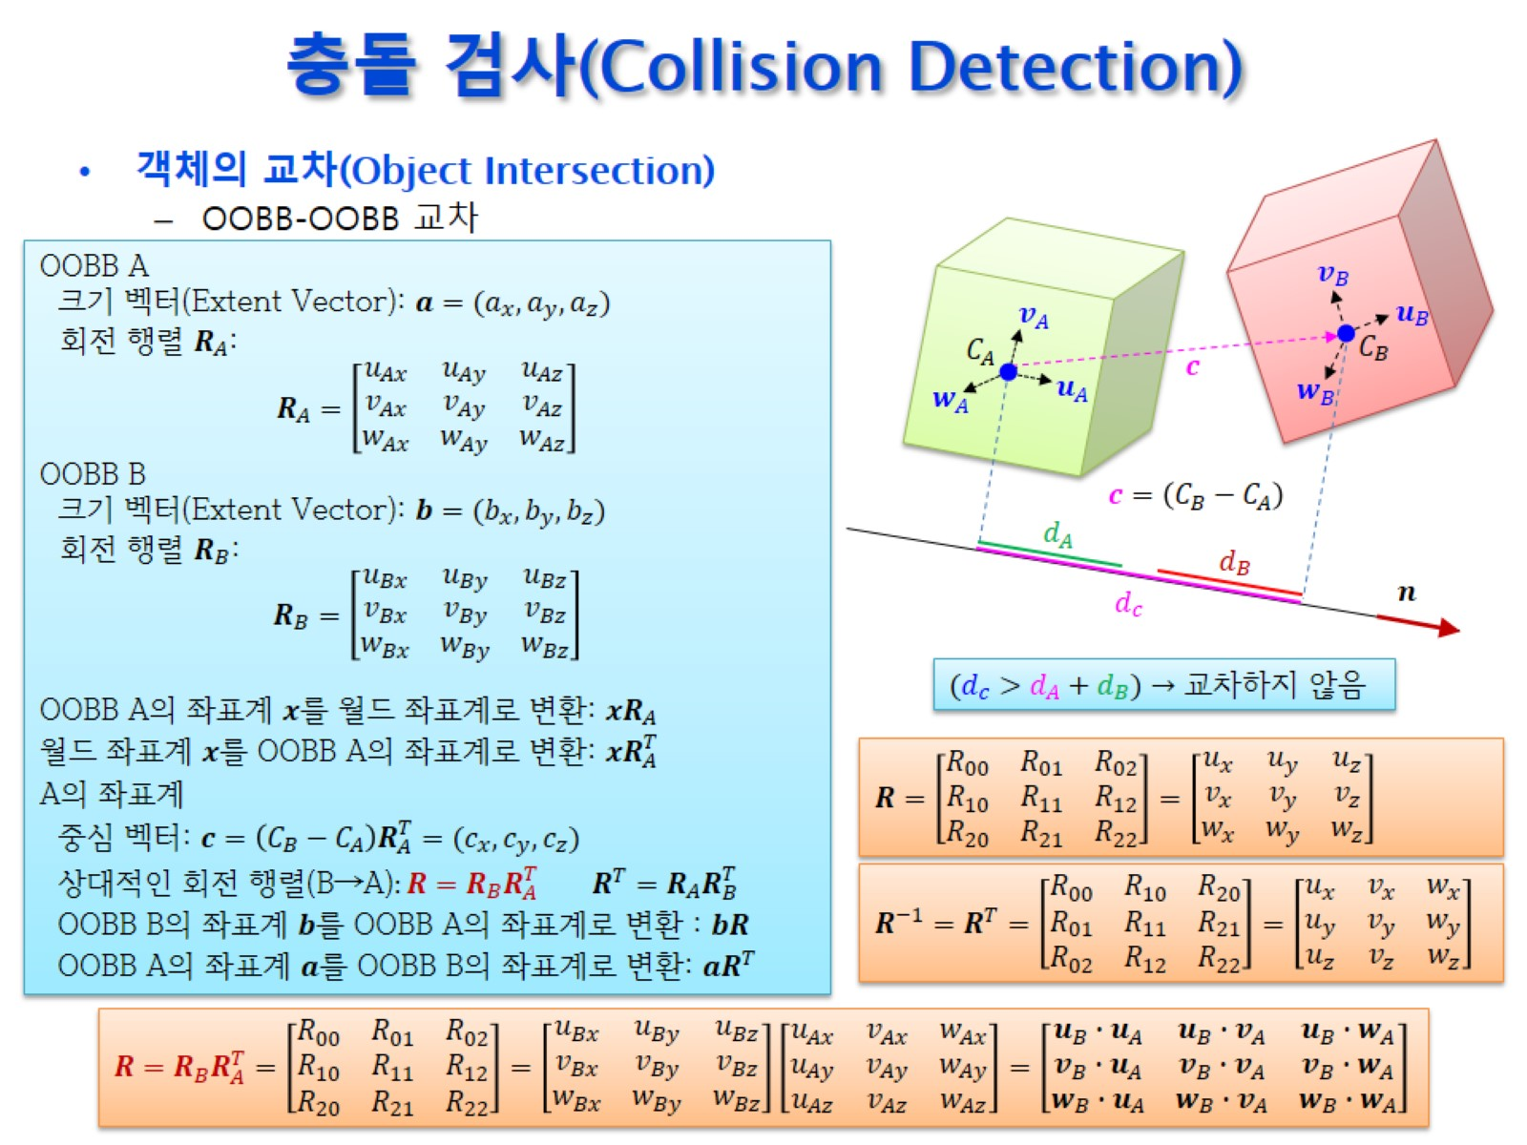
충돌 검사(Collision Detection)

Slide 39
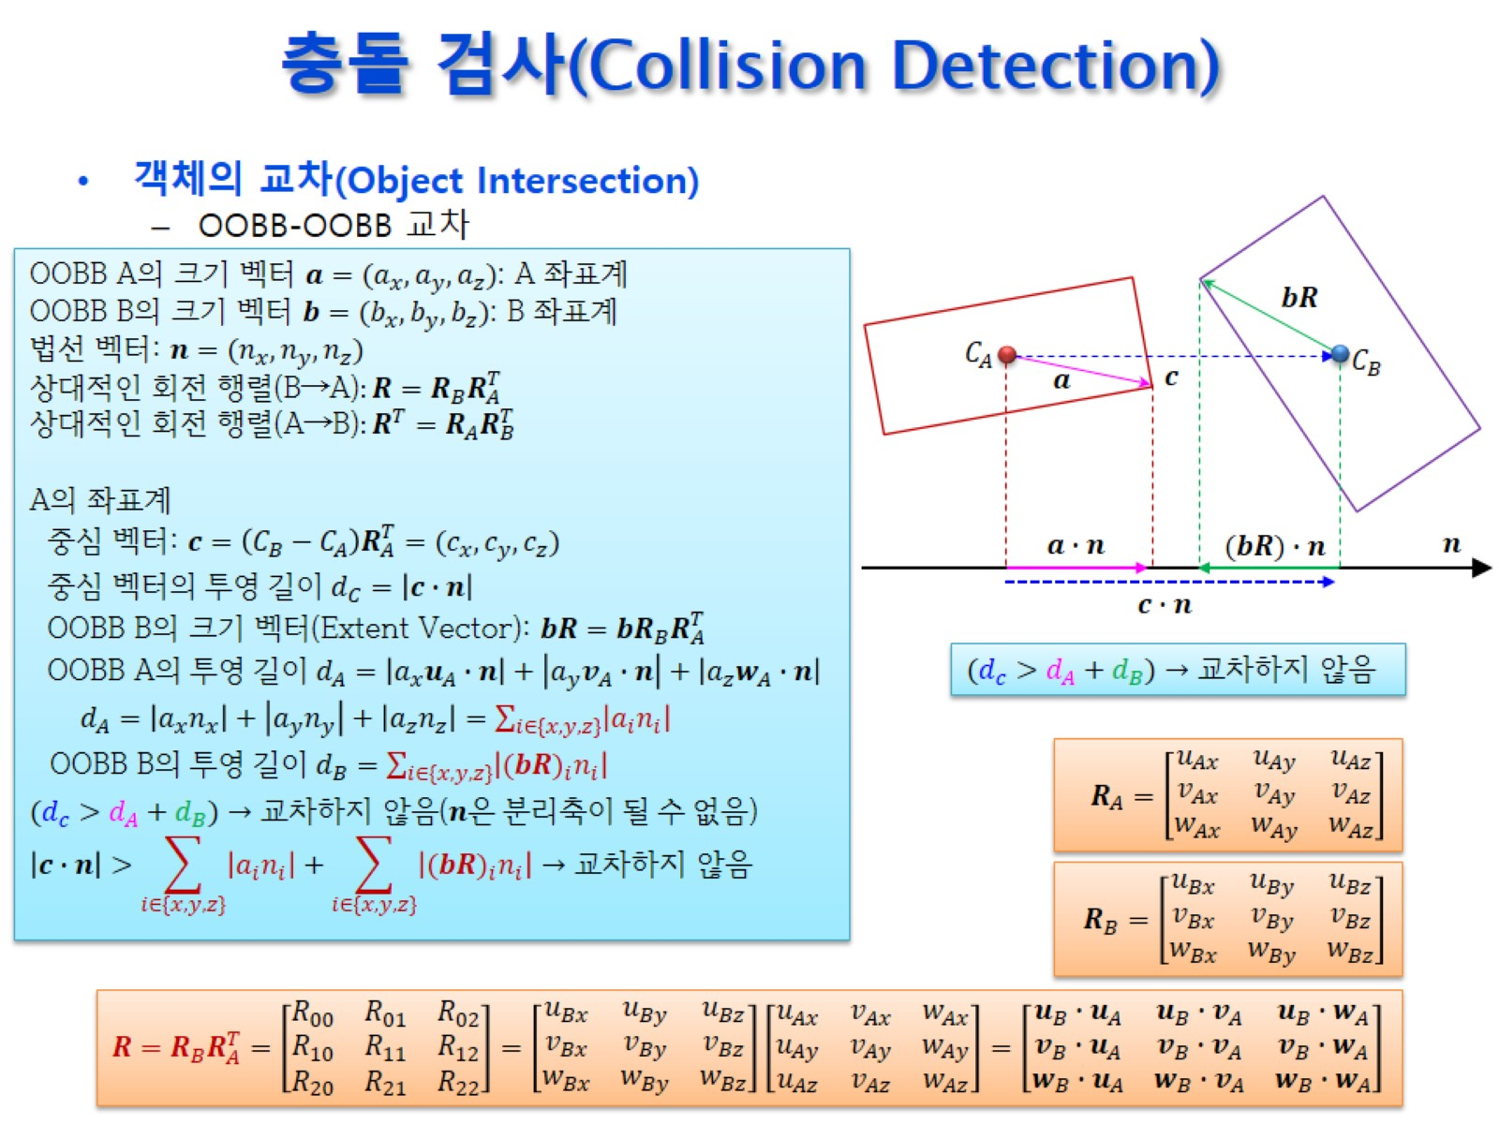
충돌 검사(Collision Detection)

Slide 40
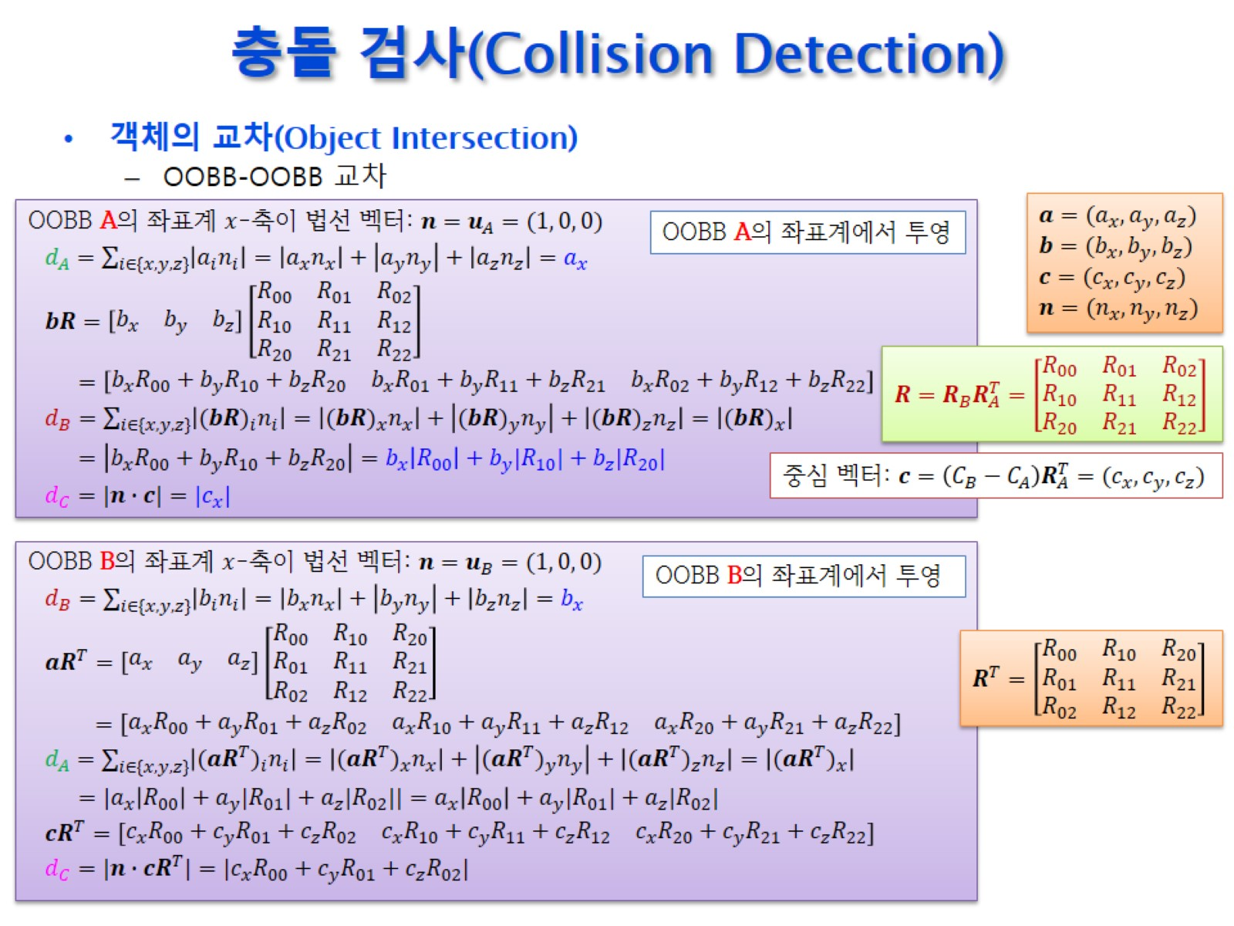
충돌 검사(Collision Detection)

Slide 41
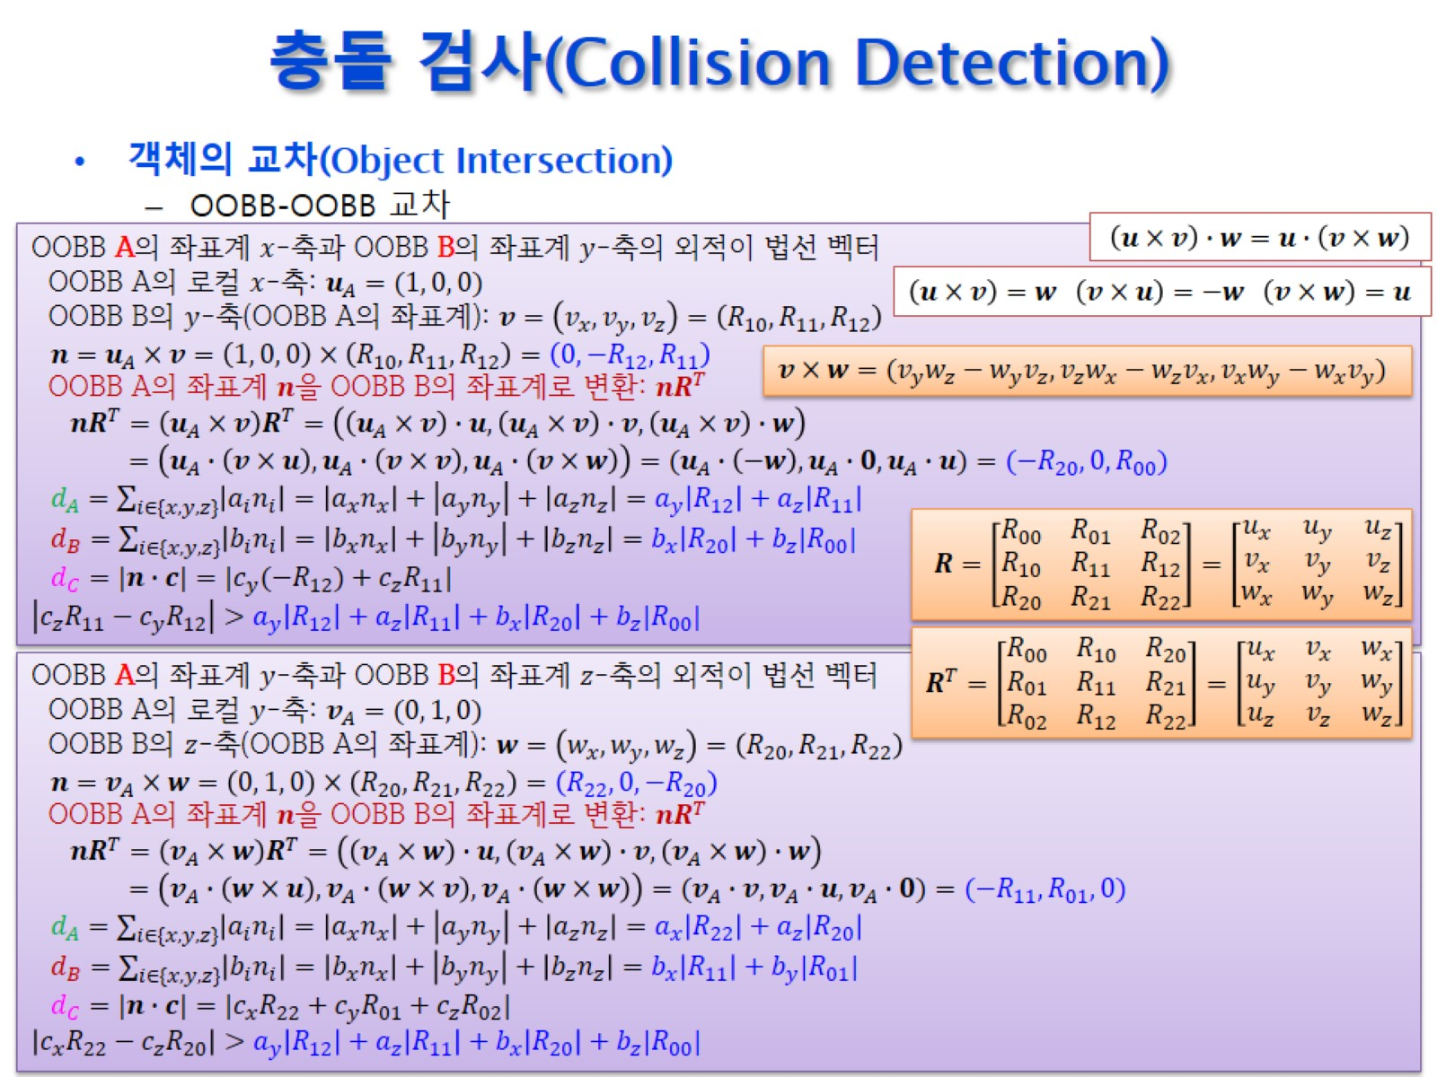
충돌 검사(Collision Detection)

Slide 42
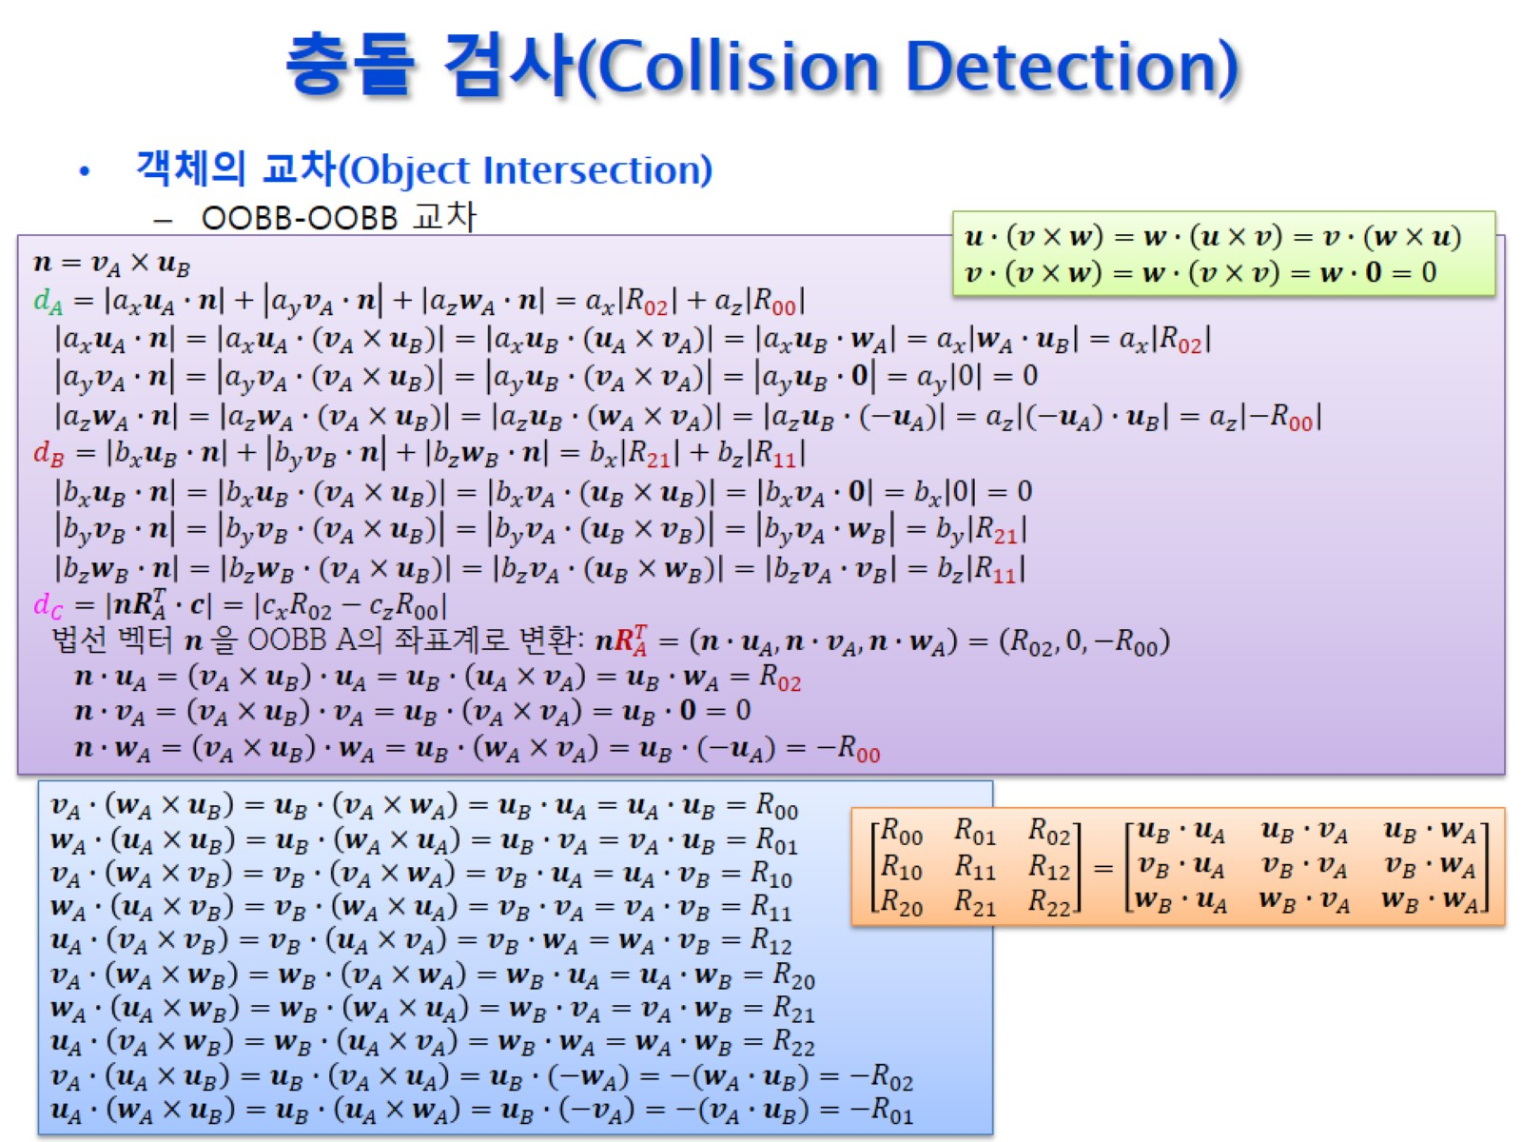
충돌 검사(Collision Detection)

Slide 43
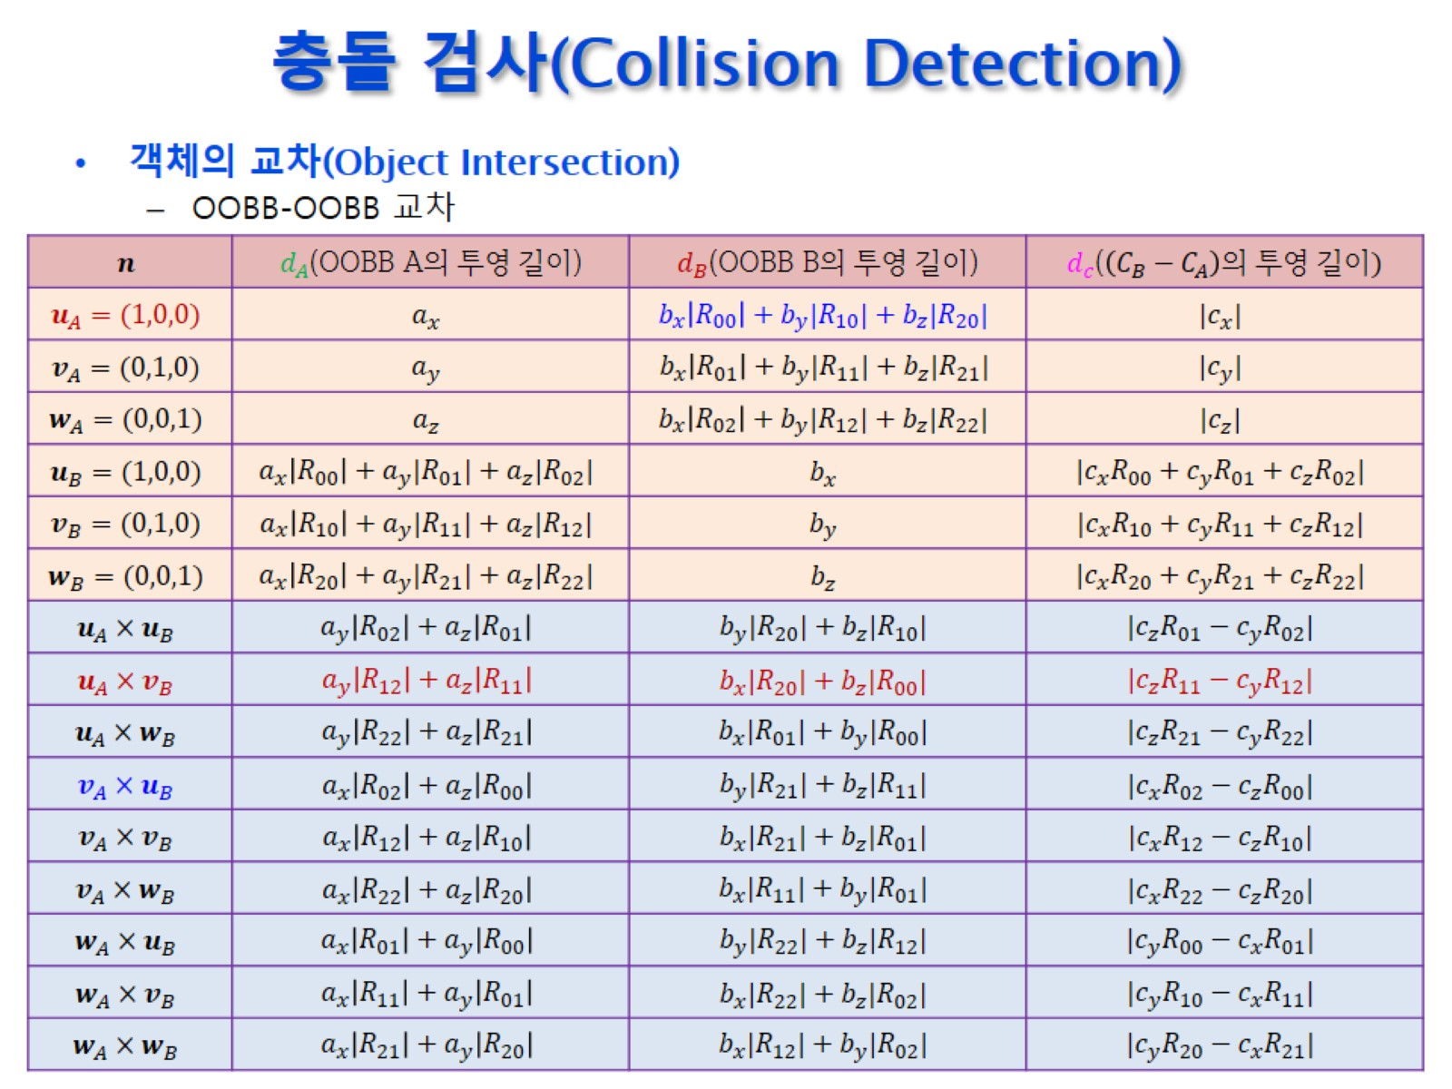
충돌 검사(Collision Detection)

Slide 44
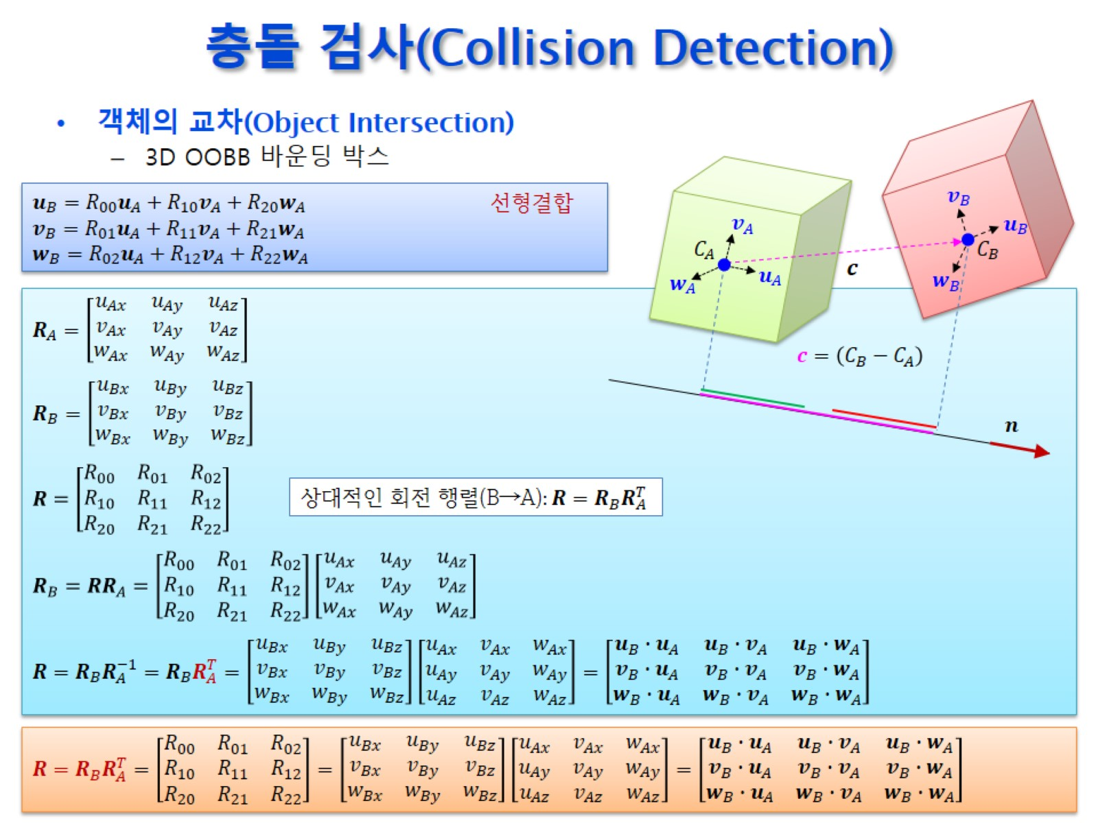
충돌 검사(Collision Detection)

Slide 45
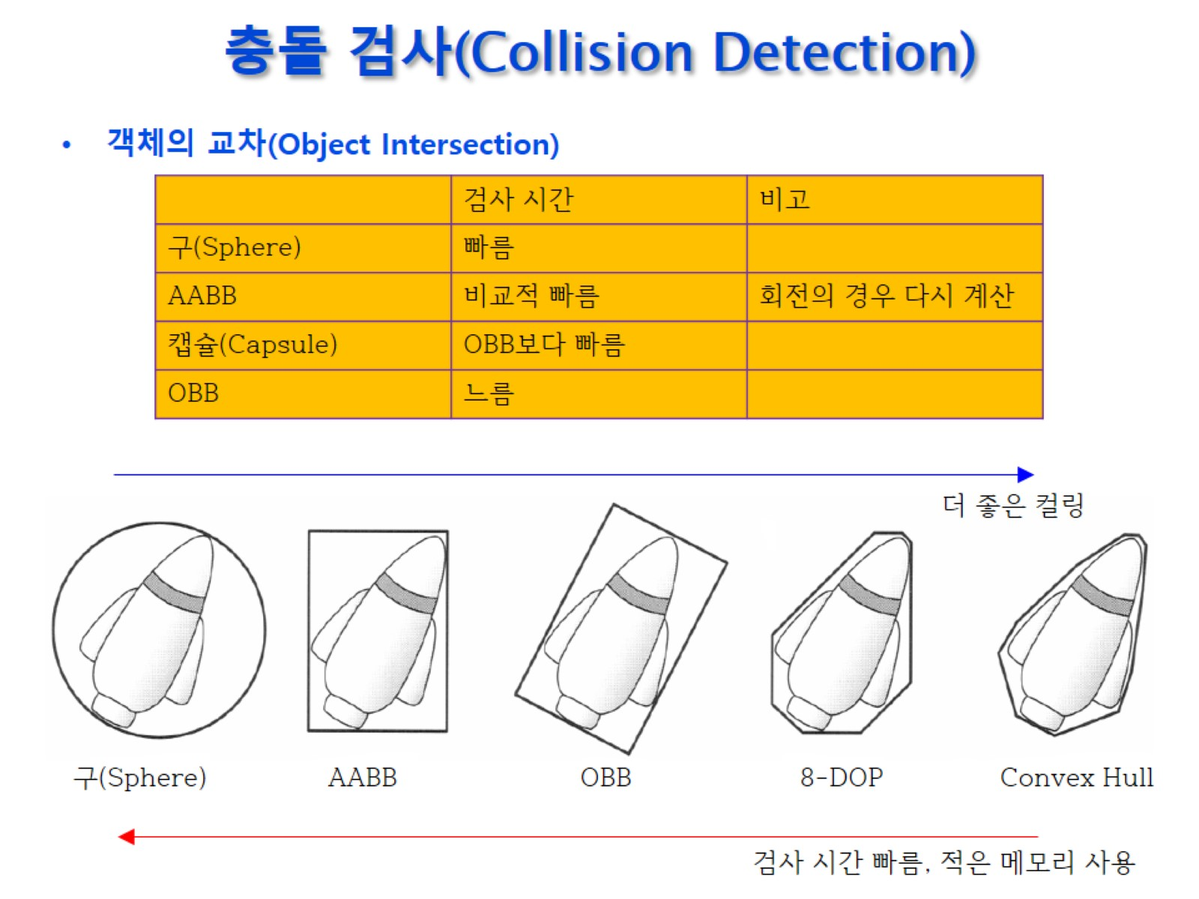
충돌 검사(Collision Detection)

Slide 46
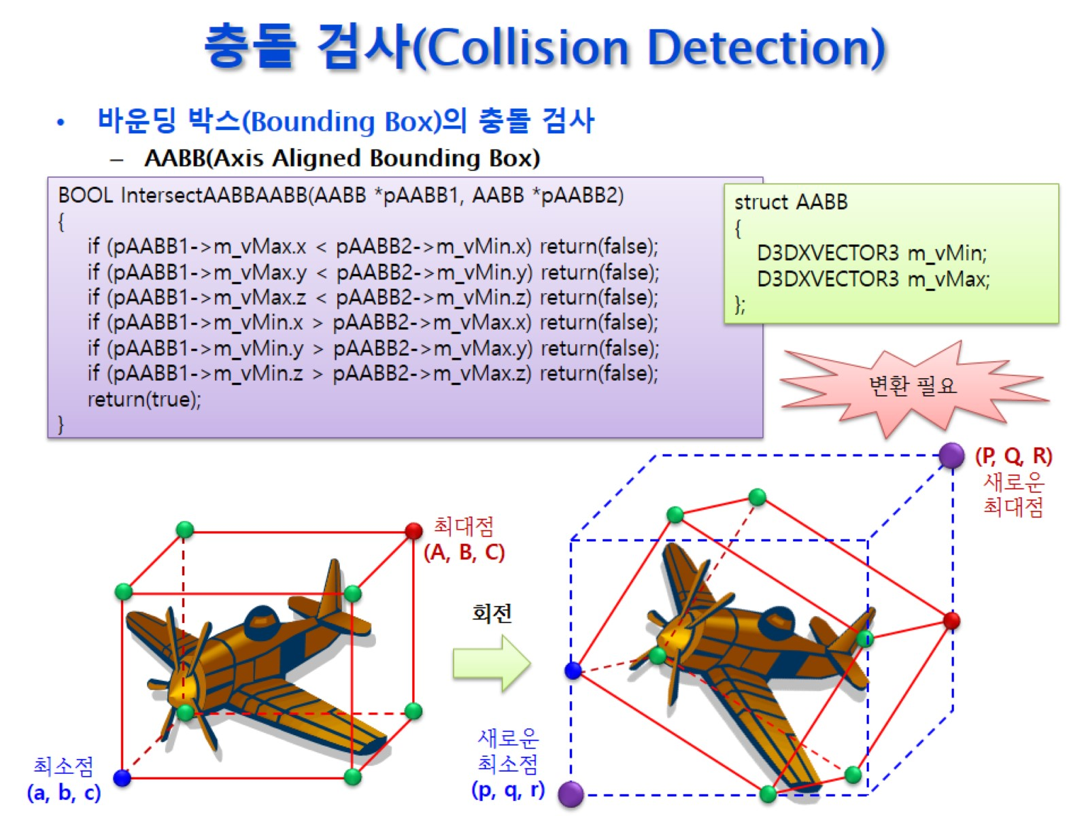
충돌 검사(Collision Detection)

Slide 47
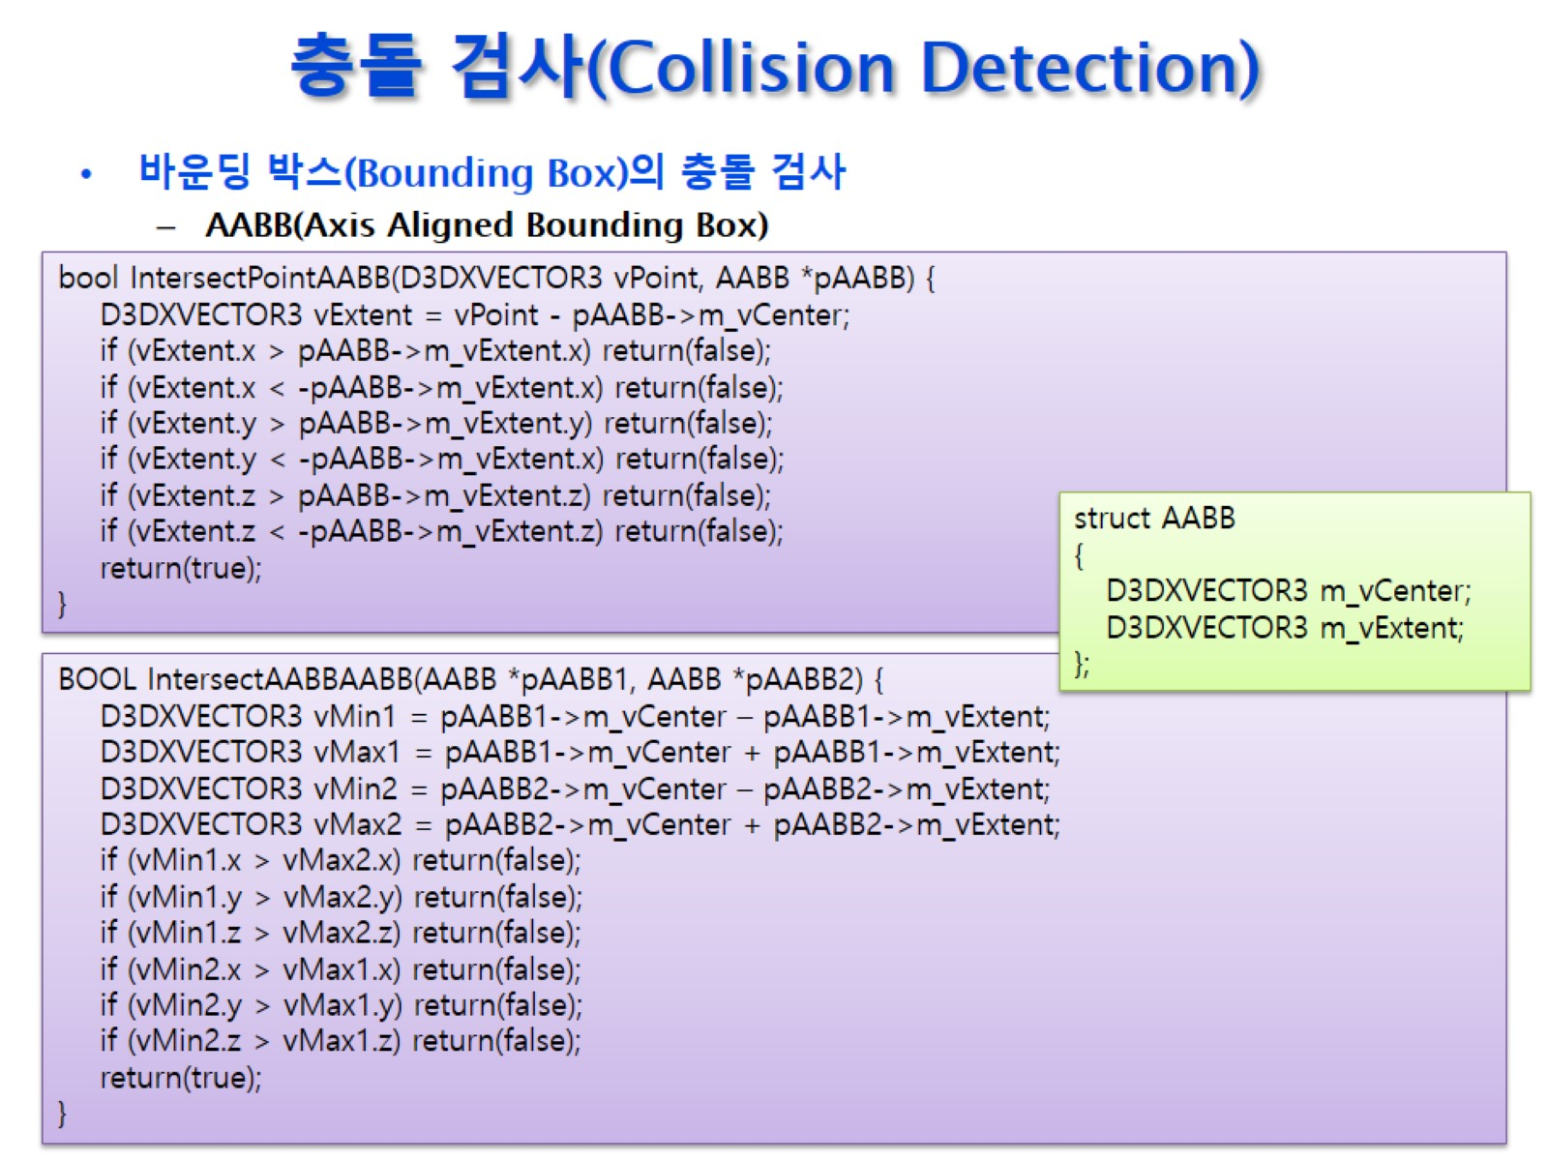
충돌 검사(Collision Detection)

Slide 48
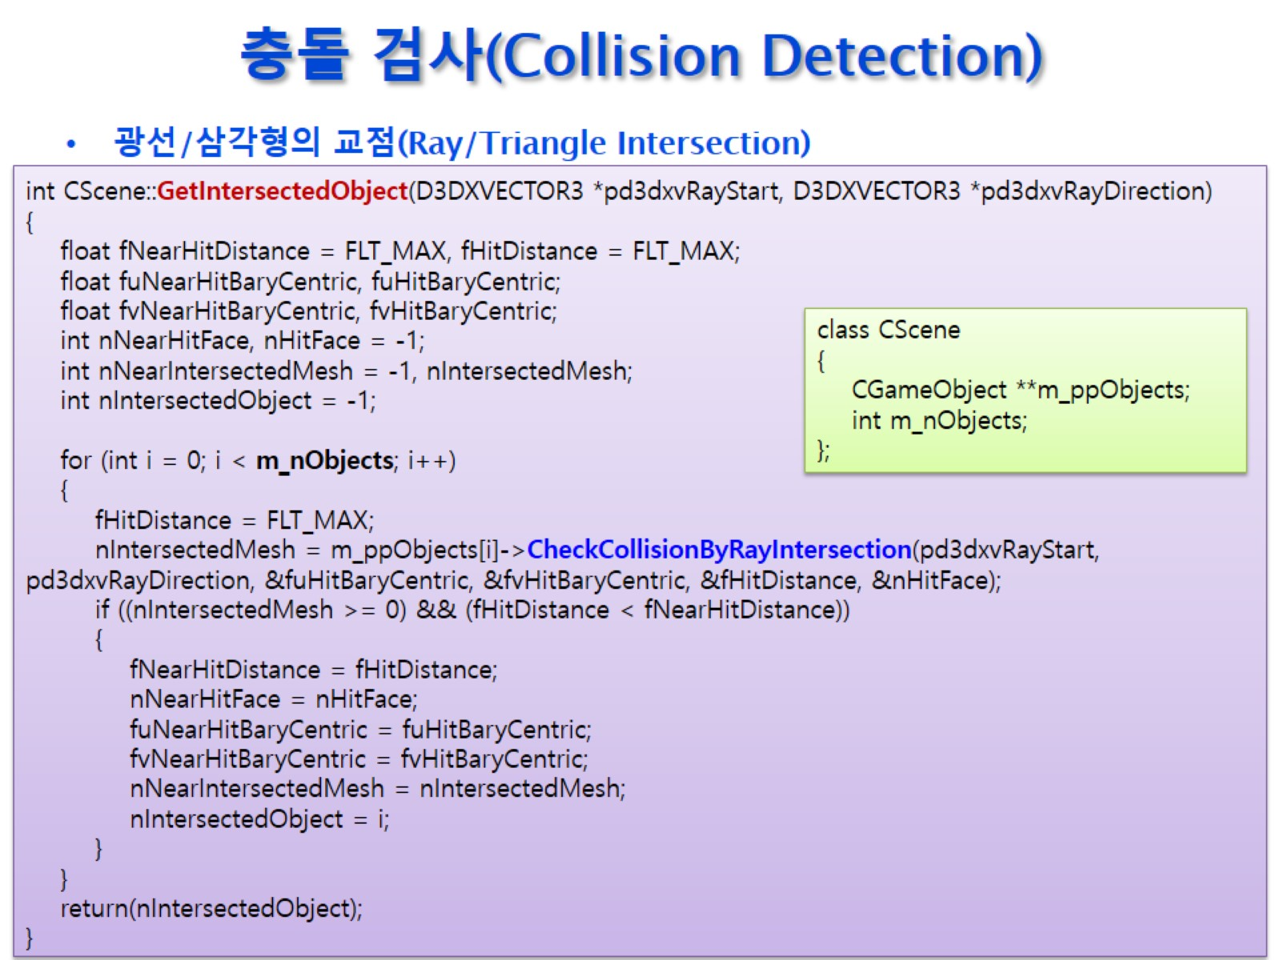
충돌 검사(Collision Detection)

Slide 49
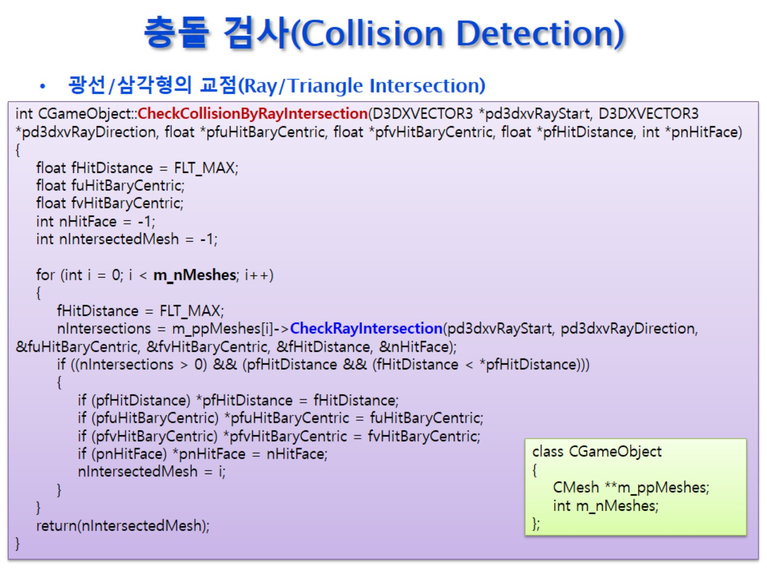
충돌 검사(Collision Detection)

Slide 50
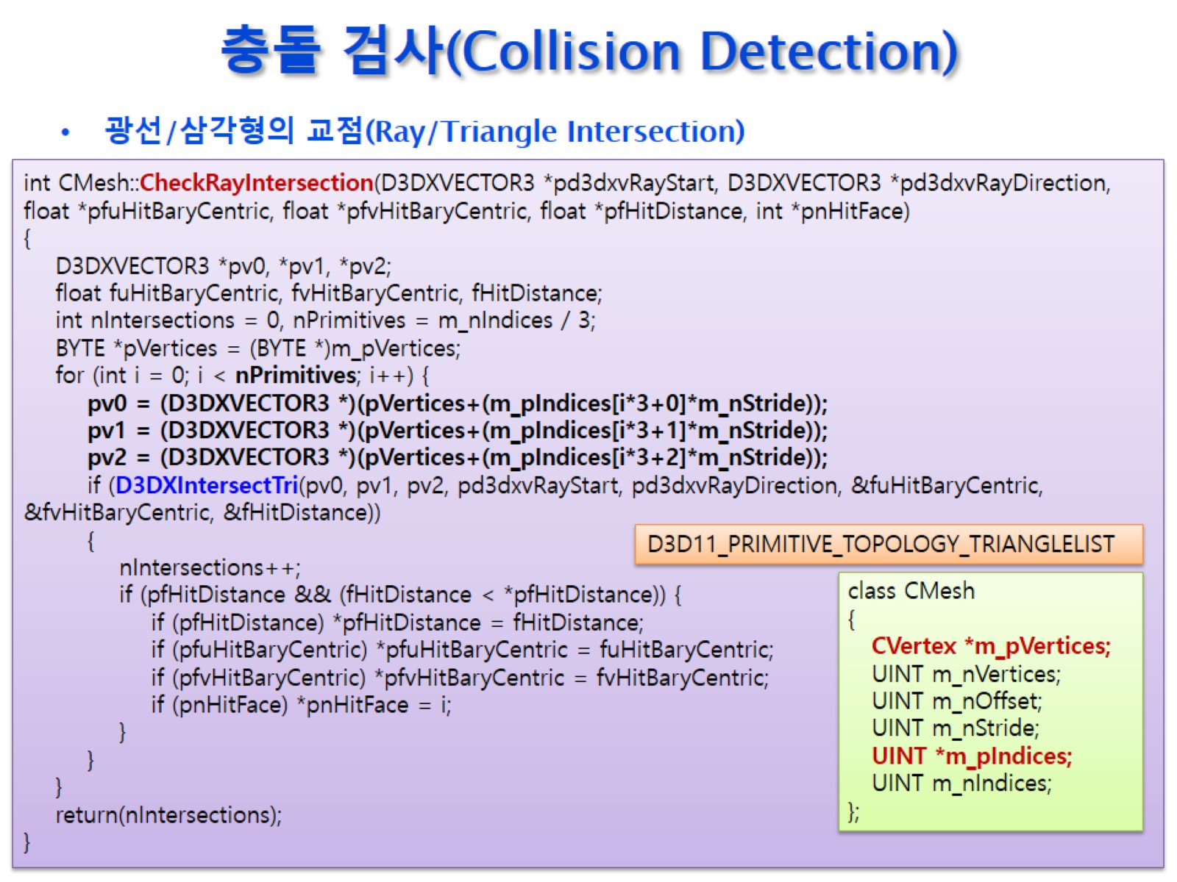
충돌 검사(Collision Detection)

Slide 51

충돌 검사(Collision Detection)

Slide 52

충돌 검사(Collision Detection)

Slide 53

충돌 검사(Collision Detection)

Slide 54

충돌 검사(Collision Detection)

Slide 55

충돌 검사(Collision Detection)

Slide 56

충돌 검사(Collision Detection)

Slide 57

충돌 검사(Collision Detection)

Slide 58

충돌 검사(Collision Detection)

Slide 59

충돌 검사(Collision Detection)

Slide 60

충돌 검사(Collision Detection)

